Slide 1
Norfolk District
North Atlantic Division
James River Maintenance Dredging
Industry Day
18 November 2025

Slide 2
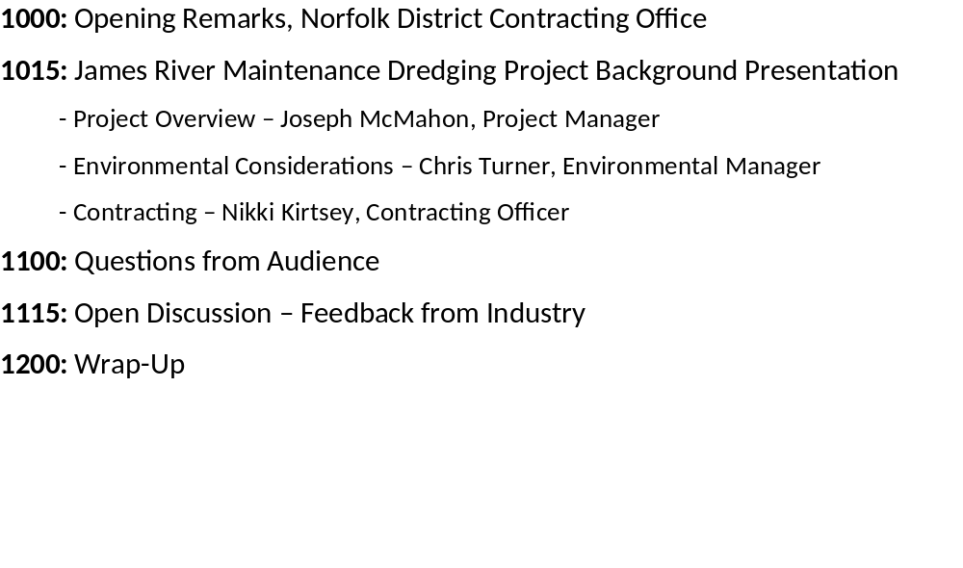
Agenda

Slide 3
Opening Remarks
Norfolk District Contracting
James River Maintenance Dredging IDIQ
& Seed Task Order
5-Year SATOC
Capacity: NTE $47,000,000
100% Small Business Set Aside
NAICS 237990 ($37 million SB Size Standard)
Estimated Dates:
FEB 2026- Invitation for Bid (Sealed Bidding) Solicitation
JUL 2026- Award

Slide 4
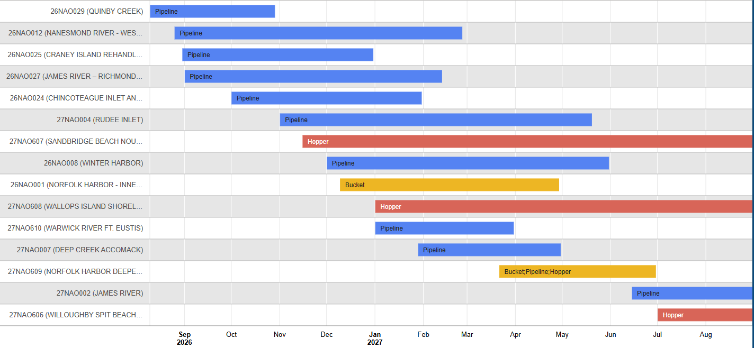
Norfolk District Dredging Program Execution Schedule FY 2025 - FY 2026
Type of Dredging Work | Project Name | Acquisition Strategy Stand Alone Contract or IDIQ | Small Business or Unrestricted | Estimated Price Range | Schedule | Notes
Cutterhead Pipeline and Mechanical Dredging | Norfolk Harbor Inner Channels and CNN Deepening | Stand Alone | Unrestricted | $50M - $100M | 3Q FY22 | 9M cubic yards; maintenance and new work dredging; fines and sands; upland placement.
Cutterhead Pipeline Dredging | James River Maintenance Dredging | 5-year IDIQ SATOC | Unrestricted | $25M - $50M | 4Q FY22 | 1M to 1.5M cubic yards; maintenance dredging; upland and overboard placement; fines and sands.
Mechanical Dredging | Norfolk Harbor Maintenance Dredging | Stand Alone | Unrestricted | $10M - $25M | 4Q FY22 | 1M cubic yards; maintenance dredging; ocean placement of dredged material at NODS. fines and sands
Hopper Dredging | Atlantic Ocean Channel Deepening (Phase 1) | Stand Alone | Unrestricted | $25M - $50M | 4Q FY22 | 2M to 2.5M cubic yards; maintenance and new work dredging; placement at Craney Island; sandy dredged material.
Cutterhead Pipeline and Mechanical Dredging | Fort Eustis 3rd Port Improvements | Stand Alone | TBD | $5M - $10M | 4Q FY22 | 25K cubic yards; marine construction and new work dredging; upland placement; fines and debris; demolition.
Cutterhead Pipeline Dredging | Lynnhaven Inlet Maintenance Dredging | Stand Alone | Set Aside to Small Business | $1M - $5M | 3Q FY23 | 200K cubic yards; beach placement and upland placement at several locations; sandy dredged material. IIJA
Cutterhead Pipeline and Mechanical Dredging | Milford Haven Maintenance Dredging and Jetty Repairs | Stand Alone | Set Aside to Small Business | $5M - $10M | 4Q FY23 | 25K cubic yards; one contract to perform jetty repairs and maintenance dredging; beach placement; sandy dredged material. IIJA
Hopper Dredging | Atlantic Ocean Channel Deepening (Phase 2) | Stand Alone | Unrestricted | $25M - $50M | 4Q FY23 | 5M to 5.5M cubic yards; maintenance and new work dredging, sandy dredged material; beach placement and placement at DNODS.
Mechanical Dredging | Southern Branch Maintenance Dredging | Stand Alone | TBD | $5M - $10M | 4Q FY23 | 250K cubic yards; maintenance material; fines and potential contamination; upland placement and landfill.

Slide 5
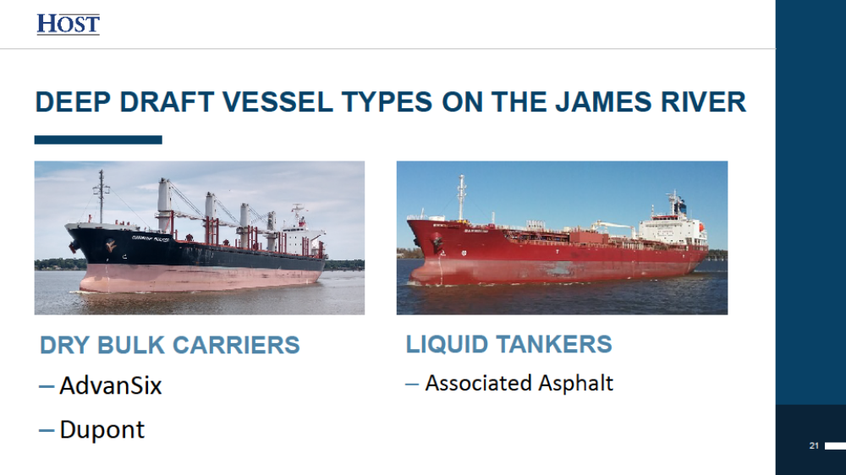
James River Channel
Vessel Types
Notes:
Commerce slide
Make a general statement that the Non-Federal Sponsor is the Virginia Port Authority

Slide 6
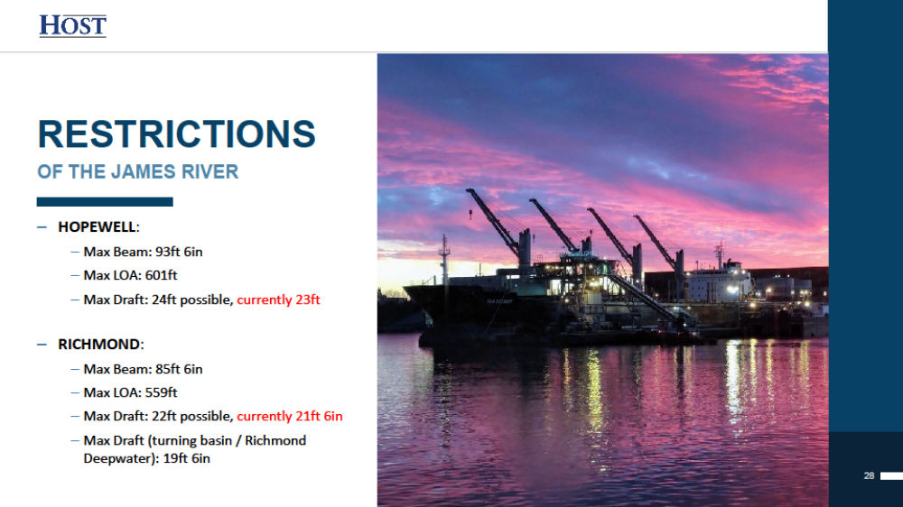
James River Channel
Restrictions
Notes:
Commerce slide
Make a general statement that the Non-Federal Sponsor is the Virginia Port Authority

Slide 7
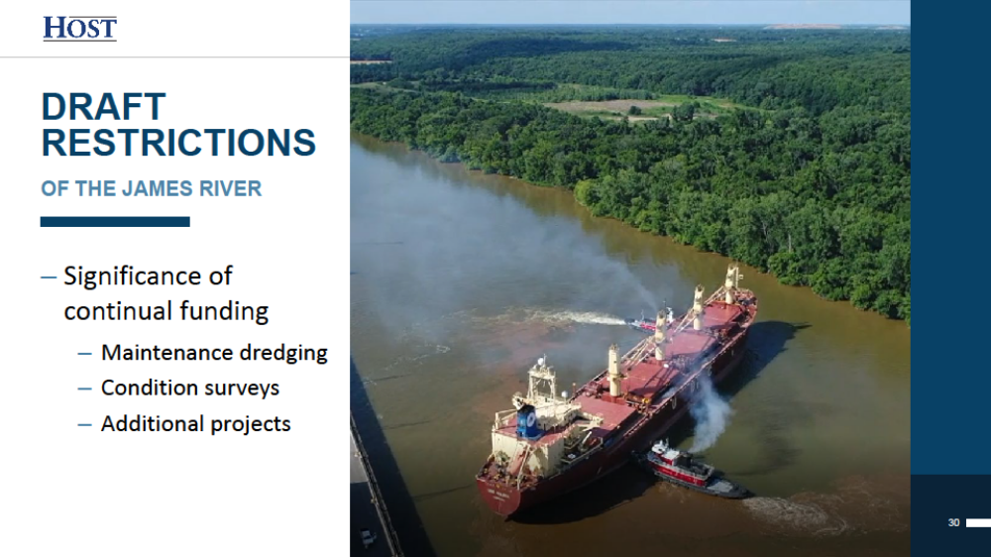
James River Channel
Restrictions
Notes:
Commerce slide
Make a general statement that the Non-Federal Sponsor is the Virginia Port Authority

Slide 8
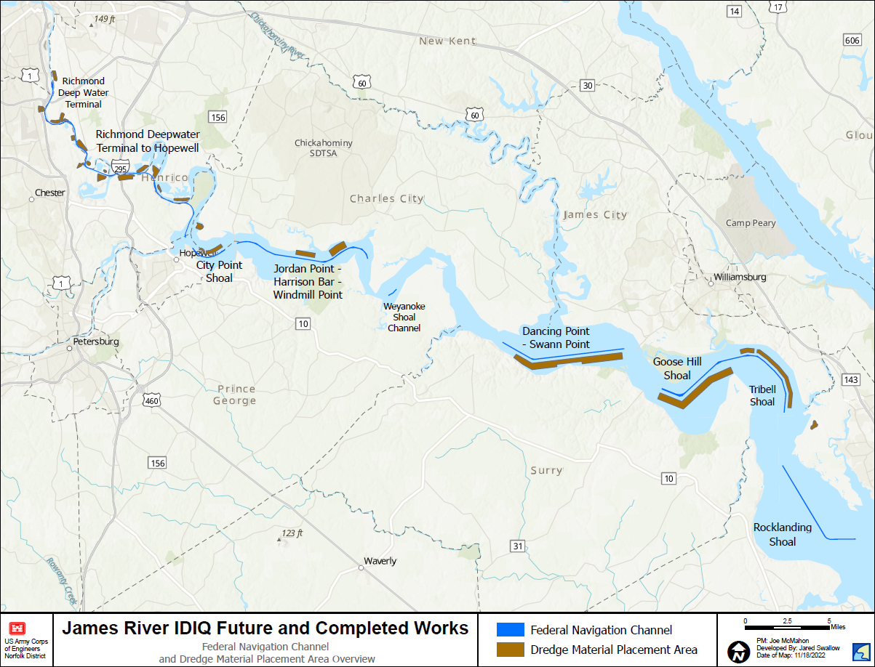
James River Channel
Scope of Work: | Maintenance Dredging
Quantity: | Approx. 1.0 MCY
Material Type: | Fines, Sand
Placement Area: | Upland and Overboard
Type of Equipment: | Cutter-head Pipeline
Environmental Windows: | No Dredging 15 Feb – 30 Jun
Notes:
90 miles of meandering waterway from Hampton Roads to Richmond, VA
Maximum pay prism depths -27 feet MLLW. Maintained width is 300 feet to Hopewell and 200 feet Richmond to Hopewell.
Approx Yearly Quantity is pay and non-pay excess yardage.
Time of Year Restriction – to be covered later

Slide 9
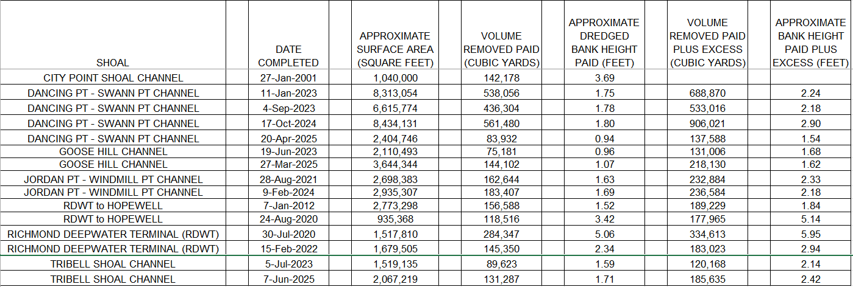

James River Channel
Bank Height (excerpt)
1 foot rule for average bank height
Average bank height calculation
No unit price adjustment due to variation of the average bank height
Notes:
Under previous IDIQ Contracts for maintenance dredging on the James River, some Task Orders were awarded that required dredging at less than the most efficient height of work face (bank height). Navigation needs on the James River will at times result in the Contracting Officer issuing Task Orders for dredging with less than the optimum bank height. The Table that follows at the end of this SECTION is a history of the Task Orders issued under the three previous IDIQ Contracts. This history is furnished for the Contractor’s information only. The Government will not be held responsible for conclusions drawn from this information. Except under emergency situations, Task Orders will not be issued for a shoal dredging area with an average bank height of less than 1 foot. Average bank heights will be computed using the required and allowable dredging volume divided by the entire, cross-hatched, dredging area, excluding side slopes. There will be no adjustment in the unit price due to variation of the average bank height.

Slide 10
James River Channel
Task Orders (Sample Scope of Work)
The work to be performed under this IDIQ Contract Task Order will be on the Middle James River and includes Dancing Point to Swann Point channel. The work to be performed are the items defined in contract and specification section 01 22 00, contract line items number XXXX, XXXX, XXXX, XXXX, and all associated work as defined in the contract specifications. Plan Drawings will not be issued for this Task Order. A Before Dredging survey of each dredging area will be performed upon receipt of the Contractor’s advance notice for dredging, as stipulated in Section 35 20 23, paragraph 1.X.X acceptance sections, Contractor designated acceptance sections shall be for contiguous areas, full width of the channel, identified by station numbers, and shall not exceed two acceptance sections for each channel segment identified for maintenance dredging within the task order issued.
The Contractor shall begin work as soon as the Notice to Proceed (NTP) is given from the Contracting Officer. The Contractor shall begin performance within XX calendar days and complete all work within XXX calendar days after receiving notice-to-proceed.
Portions of Dancing Point to Swann Point on the James River Federal Navigation Project are to be dredged in the order indicated below, up to full channel width, to the following elevations:
Dancing Point-Swann Point Channel, Station -20+00 to Station 379+33.9; -26 Feet MLLW
One foot of over depth dredging will be allowed.
Actual dredging areas, dredging widths, and associated dredging volume will be determined based on results of the Before Dredging (BD) Surveys for each channel as indicated.
Prior to the commencement of work, a Before Dredge (BD) Survey will be performed for each acceptance section to be dredged. For each acceptance section surveyed, the Government shall provide the Contractor in a timely manner, BD drawings indicating the required dredging locations, required and allowable dredging depths, and available pay volume.
Task order magnitude $500,000 to $5M; 2 to 3 Task Orders per Contract Year
Notes:
Period of Performance Considerations
Mobilization and Demobilization = 21 days
Transportation of plant and equipment between channel elements = 2 days
Production rates for the Lower and Middle James based on 7,500 cubic yards per day
Production rate for the Upper James based on 3,000 cubic yards per day (upland placement site work)

Slide 11
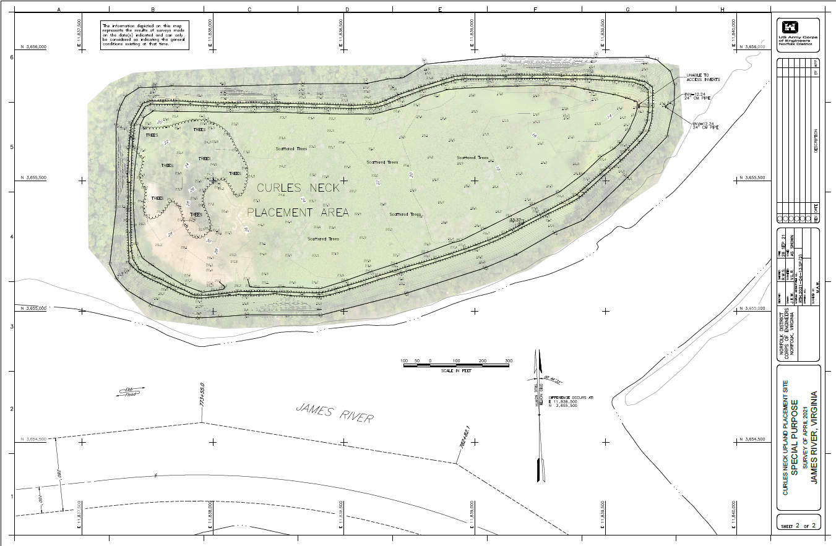
Curles Neck Upland Placement Site
Notes:
Upland Placement Site Example – Curles Neck
Maximum crest height approx. 34 feet MLLW

Slide 12
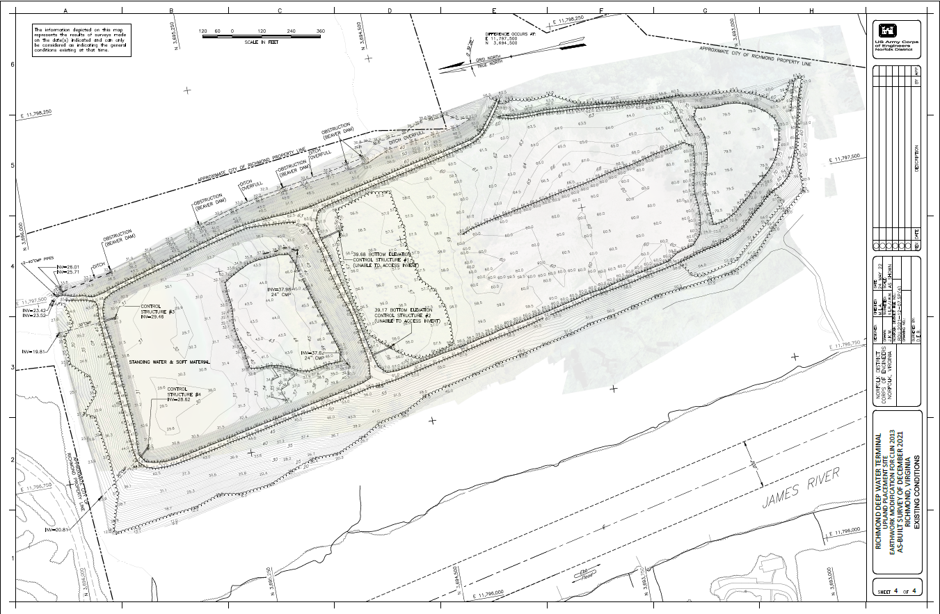
Richmond Deepwater Terminal
Upland Placement Site
Notes:
Upland Placement Site Example – RDWT
RDWT maximum crest height approx. 80 feet MLLW on south cell

Slide 13
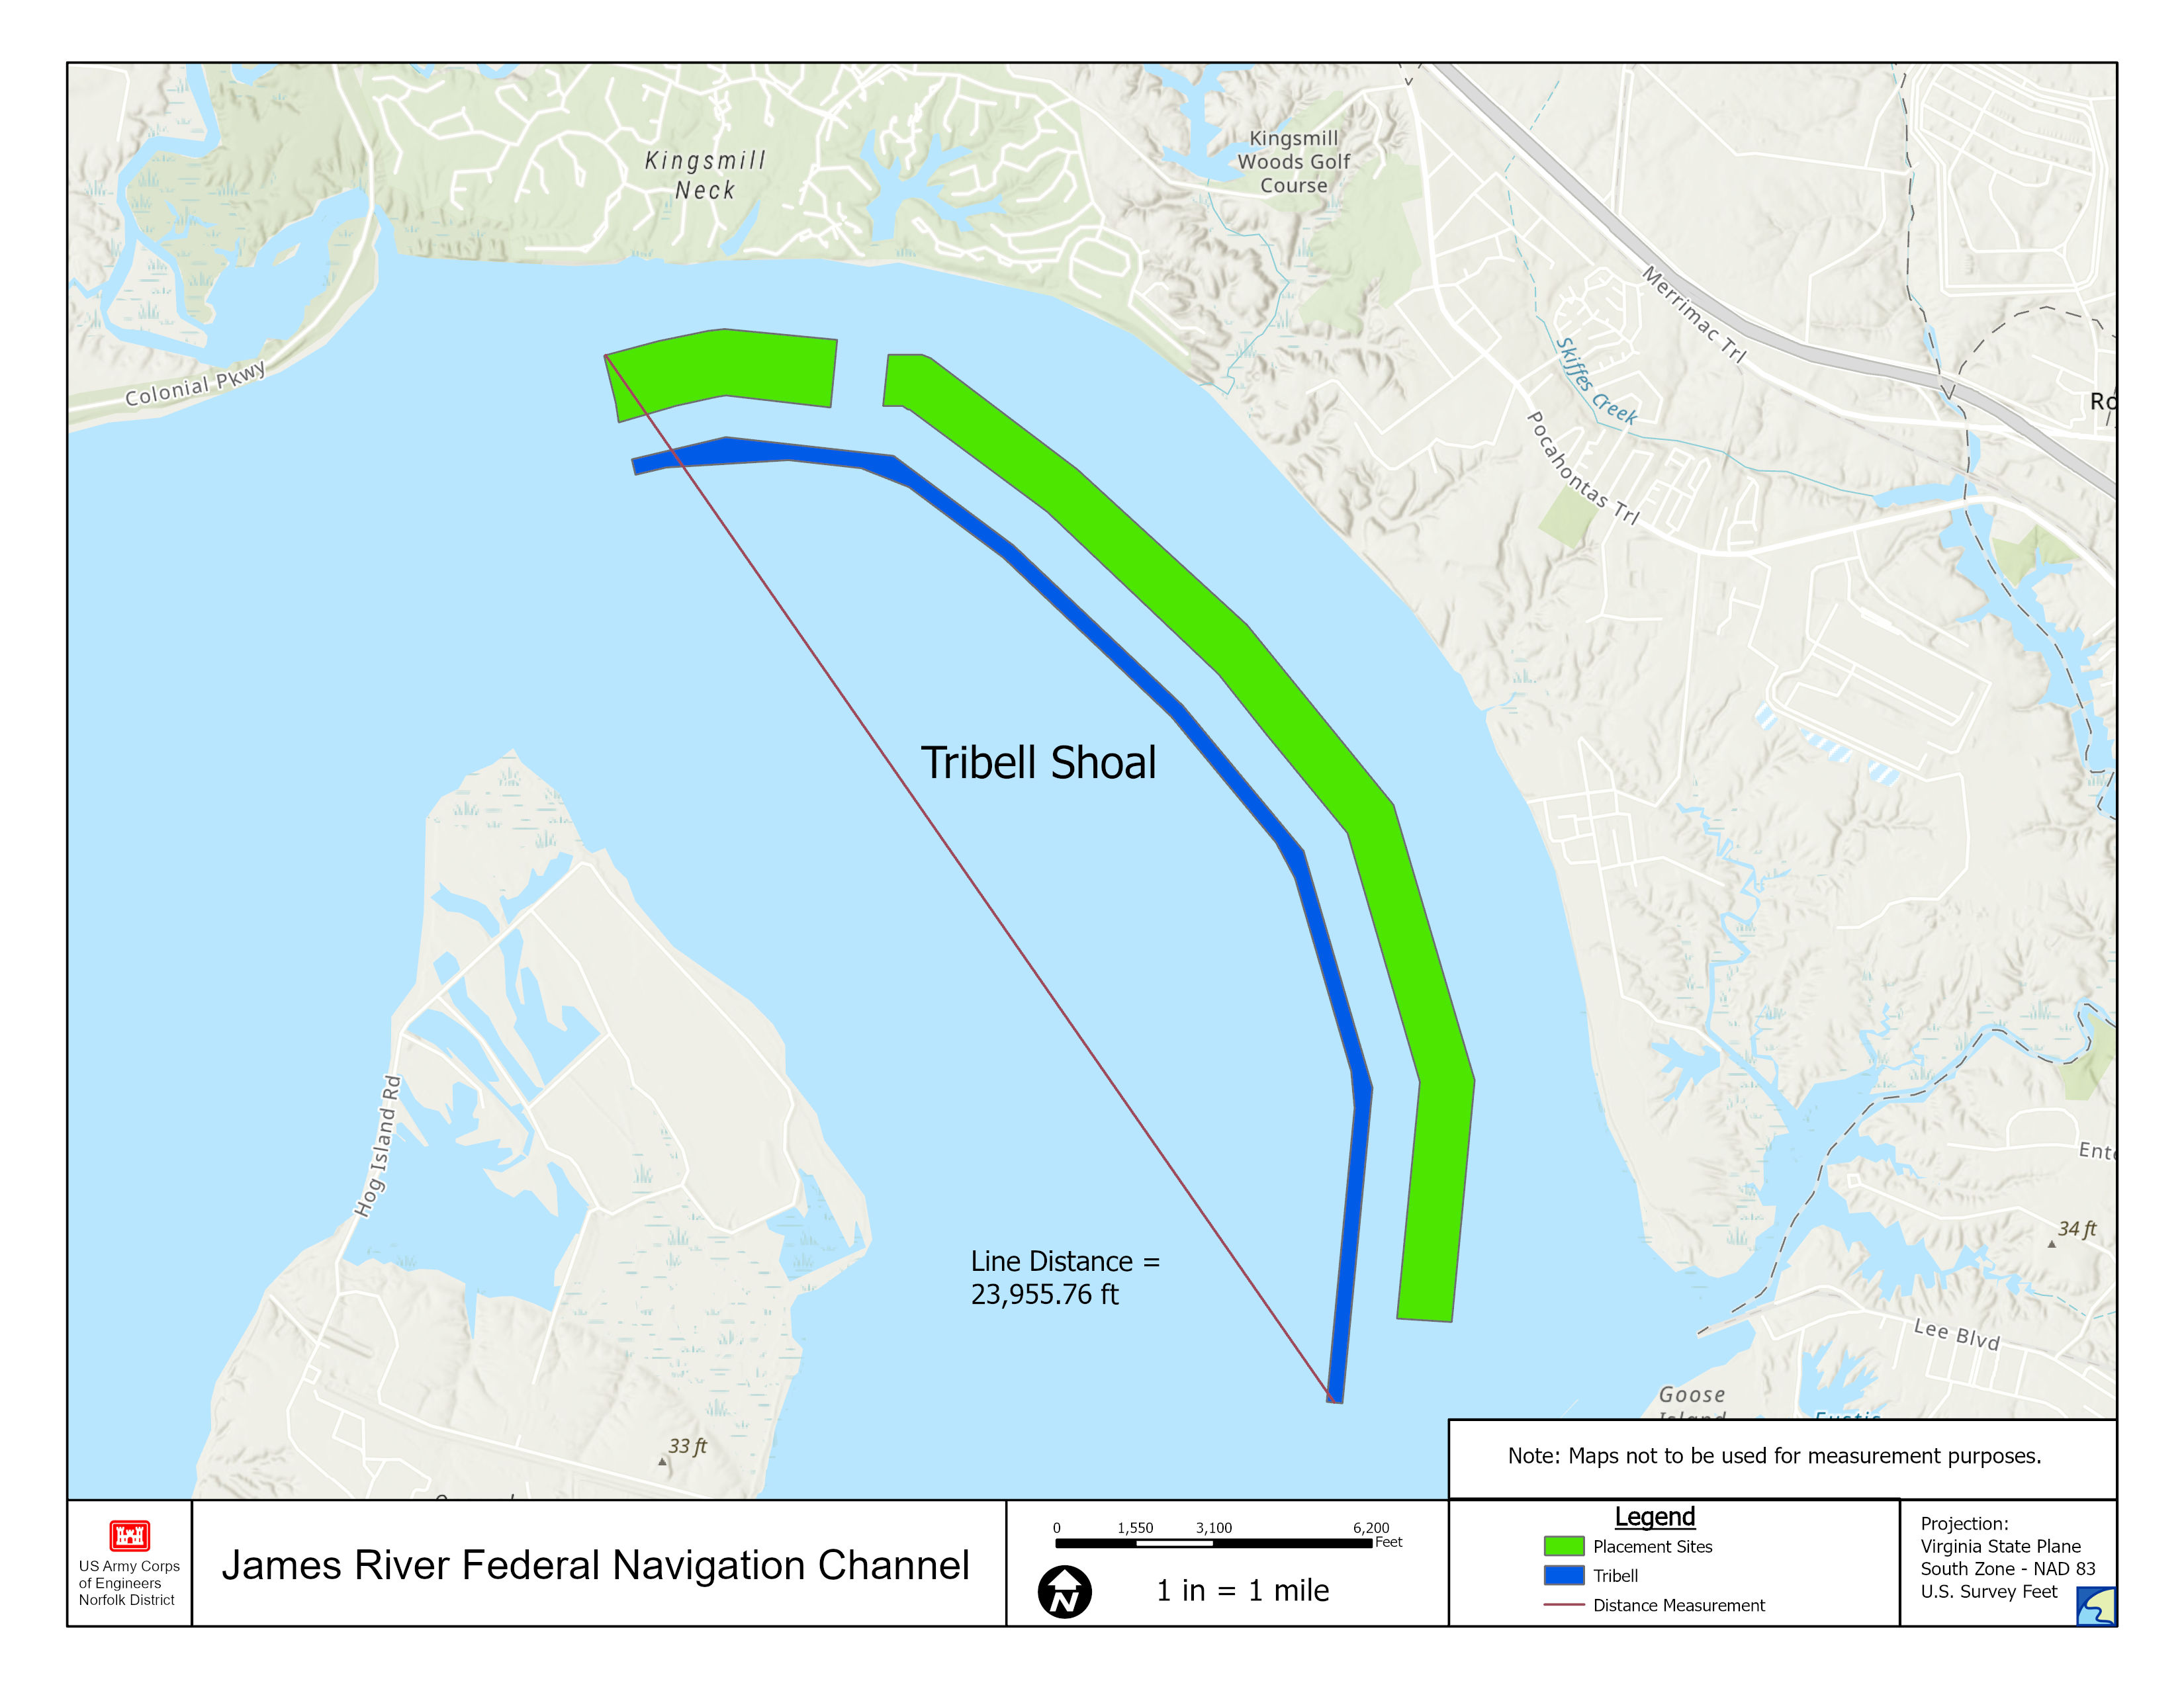
Tribell Shoal Overboard Placement Site
Notes:
Overboard Placement Site Example – Tribell Shoal
Highlight contractor capability required to pump long distances. This slide indicates the maximum pumping distance expected on the project (Upper and lower James).
Average pumping distances are not expected to exceed 10,000 linear feet for the lower/middle James, with the exception of Tribell Shoal.
Average pumping distances are not expected to exceed 7,500 linear feet for the upper James, with the exception of RDWT to Hopewell

Slide 14
James River Channel
Environmental Considerations

Slide 15
PROTECTED SPECIES
Native habitat for anadromous fish, sturgeon and other wildlife protected by federal law or species of special concern for the State of Virginia
  Time of Year Restrictions (TOYR) for dredging activities
    Lower James – February 15th through June 15th of any year to protect anadromous fish populations and shellfish
    Middle James – February 15th through June 15th for Goose Hill Shoal and February 15th through June 30th of any year for Dancing Pt – Swann Pt, Jordan Pt-Harrison Bar to Windmill Pt, and City Point Shoals to protect anadromous fish
    Upper James – February 15th through June 30th of any year to protect spawning habitat for anadromous fish

Slide 16
ENDANGERED SPECIES MONITORING
    Endangered Species Training provided by USACE
    Designate a look-out to monitor visible action area from dredge plant
      Look for parts/pieces of Atlantic sturgeon entrained in the cutterhead, floating around the dredge or collected in the inflow pond inside the upland placement area
      Document observations and notify Contracting Officer Representative ASAP
      Follow “Sturgeon Incidental Take Procedures”
        Fin clips
        Measurements, photos, specimen preservation

Slide 17
WATER QUALITY MONITORING (Upper James)
Comply with requirements for Section 404 of the Clean Water Act for discharges associated with confined disposal facilities
Manage spillboxes to ensure adequate ponding depth for effective sedimentation & to maximize use of available effective weir length ensuring that only clarified supernatant flows over the weir crest.
The Contractor must maintain a daily average Total Suspended Solids (TSS) concentration of less than 500 mg/l. The “less than” 500 mg/l TSS concentration is a threshold limit and not a TSS target or goal.

Slide 18
WATER QUALITY MONITORING (Upper James)
Environmental Testing and Upland Effluent Measurements
  TSS samples
    Collected every 12 hours at weir crest of each operating spillbox
    Hach 900/DR Colorimeter model #9385100, program 94 “Suspended Solids”, or approved equal
    1000 ml wide mouth polyethylene bottle (Nalgene 2104-0032 or equal)
    Visual inspection for clarified water required every 4 hours at each operating spillbox
    Spillboxes shall be maintained, and weir boards adjusted so that only clarified water is released.
    Dissolved Oxygen samples
      Collect instream dissolved oxygen concentrations at a minimum of once per day during return flow operations at each discharge location into receiving waters, during the period of July 1st through October 31st of any year.
      Hach Hydrolab MS5/DS5 Multiprobe Water Quality Meter or approved equal is required for DO collection.

Slide 19
WATER QUALITY MONITORING (Upper James)
Environmental Testing and Upland Effluent Measurements
  Upland Placement Site Effluent Discharge
    At the direction of the Contracting Officer and during active dredging operations of the Upper James River Shoals, chemical sampling and testing of dredged material effluent water overtopping weircrest of each operating spillbox may be required.
    CO will direct contractor to complete sampling and testing with an independent qualified analytical laboratory and environmental services provider to ensure integrity and validity of water quality compliance test results.
    Analytical laboratories must be Virginia Environmental Laboratory Accreditation Program (VELAP) certified.
    Analytical results of dredged material discharge shall be delivered to the CO.

Slide 20
ENVIRONMENTAL PROTECTION PLAN (E.P.P)
Contractor must submit E.P.P that includes:
Spill Control Plan
Hazardous Waste Controls
Non-hazardous Solid Waste Disposal Plan
Recycling & Solid Waste Disposal Plan
Contaminant Prevention Plan
Historical, Archaeological, Cultural, Biological, & Wetland Resources Plan

Slide 21
James River Maintenance Dredging
Industry Day
Questions
&
Open Discussion

Slide 22
James River Maintenance Dredging
Industry Day
Conclusion

