Slide 1
Army - Watercraft Sustainment Maintenance (A-WSM) Program Informational Meeting
Presented to:
Industry
Presented by:
Jared Chambers
Nicole Gram
ACC-WRN
Version Number 2
As of 14 November 2018

Slide 2
Agenda
Introduction and Ground Rules
Purpose and Background of A-WSM
Overview of A-WSM
Small Business Provisions
Proposed Evaluation Criteria

Slide 3
Introduction to A-WSM Contracting Team
Mr. Jared Chambers, Procuring Contracting Officer (PCO)
Ms. Nicole Gram, Contract Specialist
Ms. Karen Kennedy, Contract Specialist

Slide 4
Ground Rules
No photography or recording is permitted
Please silence all cell phones
Questions must be submitted
  On the 3x5 cards provided to you today; or
  Via email to the AWSM mailbox; all emailed questions shall be in the body of the email (not in an attachment to the email)

Slide 5
Purpose
The purpose of this presentation is to provide information regarding the A-WSM requirements, as well as, proposed solicitation structure and evaluation criteria.

Slide 6
Background
A-WSM will replace Army Contracting Command – Warren’s (ACC-WRN’s) use of five contact mechanisms
  East Coast US Multiple Award Indefinite Delivery Indefinite Quantity (MA IDIQ)
    Contractor pool with nine shipyards from Brooklyn to Tampa
    Shipyard and pier side repairs
    Expires Feb 2021
  West Coast US MA IDIQ
    Contractor pool with eight shipyards from Tacoma to Hawaii
    Shipyard and pier side repairs
    Expires Dec 2020
  Kuwait IDIQ Contract
    One shipyard in Kuwait (HEISCO)
    Shipyard and pier side repairs
    Expires Aug 2020

Slide 7
Background continued
  Japan Navy Blanket Purchase Agreements
    Facilitate pre-award activities through Navy Fleet Logistics Center (FLC) and then assume post-award functions
    Shipyard and pier side repairs
    No expiration date
  Landing Craft Utility (LCU) Service Life Extension Program (SLEP) (Contract W56HZV-16-D-0061)
    Phase II SLEP will transition to the A-WSM program upon award

Slide 8
# of Incumbent Contractors
East Coast
  Multiple Award (MA) Indefinite Delivery Indefinite Quantity (IDIQ)
  9 Small Business Contracts Awarded
West Coast
  MA IDIQ
  5 Small Businesses
  3 Other-Than-Small Business Contracts Awarded
Kuwait
  Single Award IDIQ (HEISCO) – Other-Than-Small Business Contract Awarded
Japan
  ACC-WRN orders off the Navy’s BPA
  5 Other-Than-Small Business BPAs Awarded
SLEP
  Single Award IDIQ – Other-Than-Small Business Contract Awarded

Slide 9
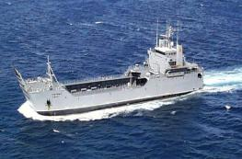
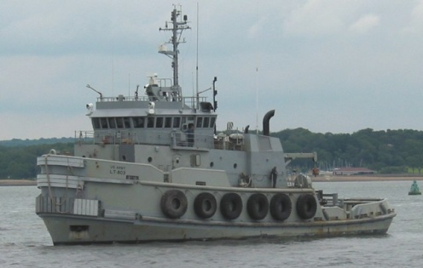
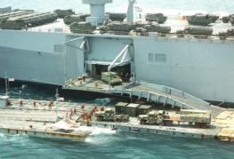
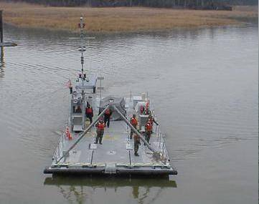
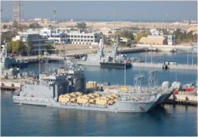
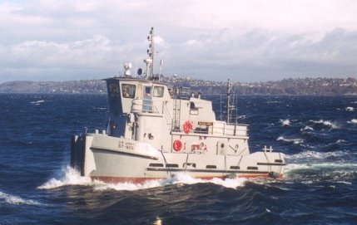
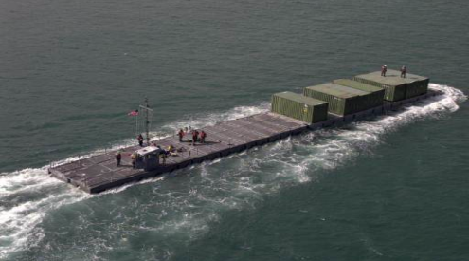
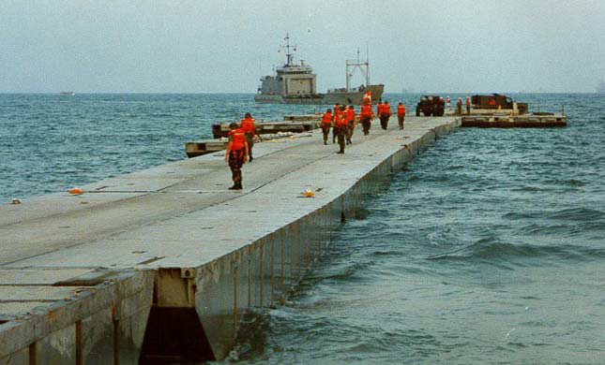
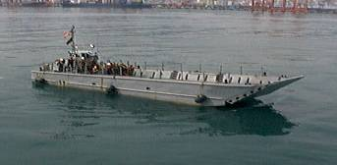
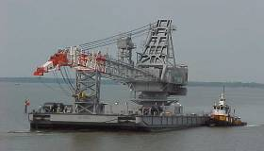
Vessel Fleet Overview
Landing Craft
ort
Ship-to-Shore Enablers
1988 – First Fielding
27 Yrs/
10 Yrs (LSV7-8)
1994 – First Fielding
23 Yrs
Modular Causeway System (MCS)
16
Yrs
14
Yrs
Logistic Support Vessel (LSV)
Large Tug (LT)
Roll-On/Roll-Off Discharge Facility (RRDF)
Modular Warping Tug (MWT)
AAO (8): 5 AC/3 RC/0 APS
AAO (8)*: 1 AC/2 RC/3 APS
AAO (6): 2 AC/0 RC/4 APS
AAO (18)*: 5 AC/0 RC/11 APS
1990 – First Fielding
26 Yrs
1998 – First Fielding
16 Yrs
22
Yrs
20
Yrs
1996 – First Fielding
Causeway Ferry (CF)
Floating Causeway (FC)
Landing Craft Utility (LCU) 2000
Small Tug (ST)
AAO (3): 1 AC/0 RC/2 APS
AAO (3): 1 AC/0 RC/2 APS
AAO (34): 7 AC/7 RC/20 APS
AAO (16): 2 AC/6 RC/8 APS
1967 – First Fielding
45 Yrs
1999 – First Fielding
17 Yrs
Small density fleet (132 complex system of systems)
No single OEM or Organic Depot support
Many different configurations
Several platforms at or past Economic Useful Life
51% in Army Prepositioned Stock (APS 4 and 5)
Unique requirements (Code of Federal Regulations)
(To be displaced by the MSV(L))
Landing Craft Mechanized (LCM-8)
Barge Derrick (BD)
AAO (36): 9 AC/9 RC/18 APS
AAO (6)*: 0 AC/2 RC/2 APS
* Currently short of the AAO.

Slide 10
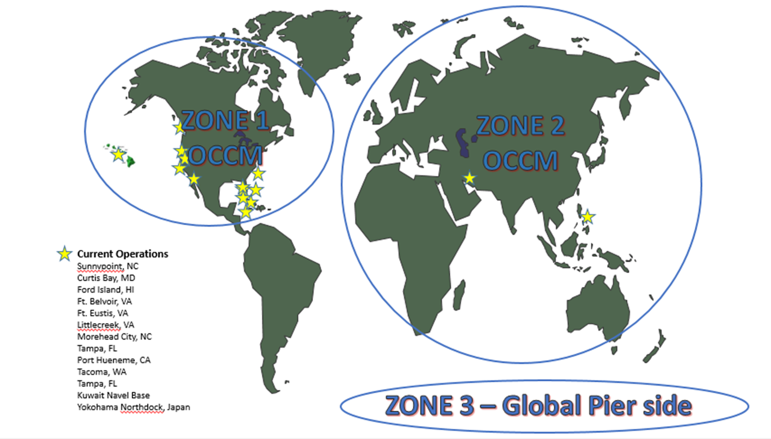
Future Contract Strategy
Japan
25%
Hawaii
3%
Antarctica

Slide 11
Future Contract Strategy
Army - Watercraft Sustainment Maintenance (A-WSM) Family of Contracts (FoC)
  Separate contract vehicles will be executed under one overarching mechanism
  One Source Selection Evaluation Board, one set of program documents
  Three distinct Requests for Proposal will result in multiple IDIQs
MA IDIQs will be broken down by geographic location:
  Zone 1- CONUS OCCM (East and West Coast) *Includes Alaska and Hawaii
    Shipyard repairs requiring dry-dock
    Shifts two separate East and West contracts under one vehicle (East & West Coast US)
    Incorporates CONUS LCUs, LSVs and CFs requiring SLEP
  Zone 2 OCONUS
    Shipyard repairs requiring dry-dock
    Incorporates vessels located in APS 4, APS 5 LCUs, LSVs and CFs requiring SLEP
  Zone 3-World-Wide Pier Side Repairs
    Ship yard repairs not requiring a dry-dock
    Currently executed under the shipyard contract

Slide 12
Watercraft Mission
The Army Watercraft Sustainment Maintenance Program Requirements consist of:
  Shipyard/On Condition Cyclic Maintenance (OCCM) - scheduled maintenance
  Modification items for Product Director - Army Watercraft Systems
  Emergency/Pier side-unscheduled maintenance

Slide 13
Scope of A-WSM
Task orders (TOs) issued against A-WSM will be for requirements that fall unto one of the following three zones: (1) CONUS; (2) OCONUS; (3) Pier Side
Specific tasks can be found in Section C of the Statement of Work

Slide 14
Overview of A-WSM
Currently conducting the first Watercraft acquisition planning effort by ACC - WRN for the follow on contracts
$540 Million maximum ordering value
Five-year Ordering Period
TOs may be placed any time during the ordering period.
On/Off-ramps may be utilized

Slide 15
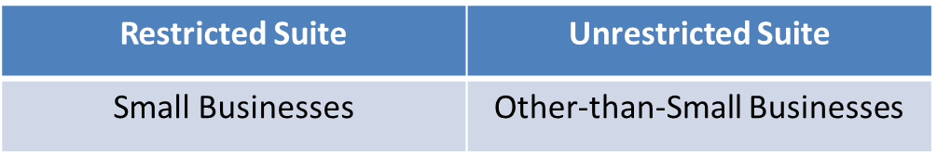
Solicitation Structure
A-WSM will have three separate zones for proposal submission and evaluation purposes.
All Offerors shall have the capability to perform the entire SOW in accordance with Section C.

Slide 16
OCCM Small Business Participation
Dry Dock Services
NAICS: 336611
Pier side Services
NAICS: 488390
Zone 1
CONUS
Zone 2
OCONUS
Zone 3
CONUS & OCONUS
Unrestricted Suite:
LSV
LCU
Unrestricted Suite:
LSV
LCU
ST
LT
MCS
(CF, SLWT, RRDF, MWT)
LCM
Pontoons
Unrestricted Suite:
LSV
LCU
ST
LT
MCS
(CF, SLWT, RRDF, MWT)
LCM
Pontoons
Restricted Suite:
ST
BD
LT
MCS
(CF, SLWT, RRDF, MWT)
LCM
Pontoons

Slide 17
SB Provisions
Rule of Two will be performed on every TO
  If Rule of Two is not met, the TO will be open for competition between both the Restricted and Unrestricted Suite Contractors
  Remember, SBs can compete on every task order, even if it is solicited on an Unrestricted basis.

Slide 18
MA IDIQ Source Selection Process
The evaluation of proposals submitted in response to the A-WSM solicitation is intended to be conducted on a Best Value basis using Source Selection Trade-Off Procedures in accordance with FAR Subpart 15.3

Slide 19
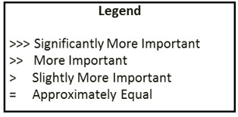
Proposed MA IDIQ Evaluation Criteria
Per FAR Subpart 15.304(e), all non-price factors when combined are significantly more important than the cost/price factor.
*The proposed evaluation criteria is subject to change. The Government may not evaluate price under 10 U.S.C. 2305(a)(3)(C).
Past Performance
Price
Small Business Participation
>>>
>

