Slide 1
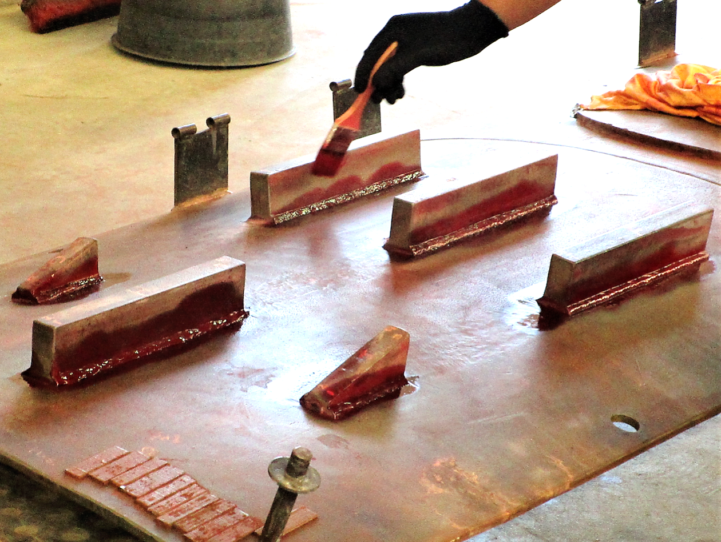
Nondestructive Evaluation (NDE) of Railroad Tank Cars (1-line header)
PROJECT DESCRIPTION
Disseminate prior NDE probability of detection (POD) results/findings with the tank car industry
and stakeholders.
Conduct a feasibility study to identify the capabilities/limitations of new and advanced NDE methods for tank car inspections.
Investigate the effects of corrosion on railroad tank car structures and the potential use of state-of-the-art
NDE methodologies for remaining tank car shell thickness measurement.
Gather information on the newer types of tank cars and the common failure modes and determine if newer weld test panels are needed for future POD studies.
Example Template
RAILROAD IMPACT
PROJECT PARTNERS
Provides inspection reliability – a key consideration in the safety and operations of tank cars.
Increases safety through technological development.
Addresses industry needs in the areas of maintenance, inspection, and damage tolerance.
Quantification of the NDE methods through POD metrics provides direction and insight into the current capabilities of the industry when using the allowed
NDE methods.
Provides for operator and procedure qualifications.
Transportation Technology Center, Inc.
Tank car industry and stakeholders
NDE equipment OEMs
COST & SCHEDULE
FY20 Funding: $540,000
Project Duration: October 2018 – September 2021
PROJECT MANAGER: Name • Phone • email​

Slide 2
Nondestructive Evaluation (NDE) of Railroad Tank Cars
Nondestructive Evaluation (NDE) of Railroad Tank Cars (2-line header)
PROJECT DESCRIPTION
Disseminate prior NDE probability of detection (POD) results/findings with the tank car industry
and stakeholders.
Conduct a feasibility study to identify the capabilities/limitations of new and advanced NDE methods for tank car inspections.
Investigate the effects of corrosion on railroad tank car structures and the potential use of state-of-the-art
NDE methodologies for remaining tank car shell thickness measurement.
Gather information on the newer types of tank cars and the common failure modes and determine if newer weld test panels are needed for future POD studies.
Example Template
RAILROAD IMPACT
PROJECT PARTNERS
Provides inspection reliability – a key consideration in the safety and operations of tank cars.
Increases safety through technological development.
Addresses industry needs in the areas of maintenance, inspection, and damage tolerance.
Quantification of the NDE methods through POD metrics provides direction and insight into the current capabilities of the industry when using the allowed
NDE methods.
Provides for operator and procedure qualifications..
Transportation Technology Center, Inc.
Tank car industry and stakeholders
NDE equipment OEMs
COST & SCHEDULE
FY20 Funding: $540,000
Project Duration: October 2018 – September 2021
PROJECT MANAGER: Name • Phone • email​
Notes:
Project Aim: Integrate diverse track data to identify safety-critical locations and analyze derailment risk.
Product: AI based deployable analytics utility to provide predictive risk scores and map-based maintenance prioritization
RR benefits: Enhanced safety and reduced derailment risk through an innovative AI-driven integration of isolated datasets

