Slide 1

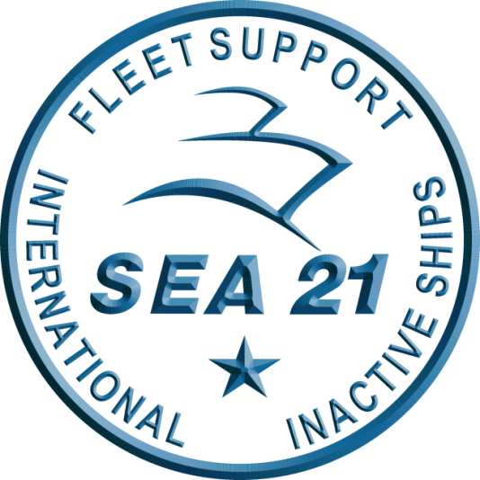
Domestic Private Sector Workload Estimate
CMAV Workload
FY23 Q3 – FY24 Q3 as of 01 APRIL 2023
Industry Version
“This information is to provide U.S. DoD industry contractors a general schedule (for information and planning purposes only) for upcoming surface ship maintenance periods - It does not constitute any request for information or request for proposals, nor is it a commitment to contract for work in accordance with this plan. This information is provided to U.S. DoD industry contractors to give a broad overview of frequently changing (driven by U.S. Navy operations) maintenance schedules and is not a guarantee of exact workload or ship schedules”
“Distribution Statement A: Approved for Public Release; Distribution is unlimited.”

Slide 2
Notes
Data contained in this report reflects the Navy program of record as of 01 APR 2023.
This report is provided to our CONUS industry partners for information and planning purposes only. The information provided reflects a broad overview of current maintenance schedules and is subject to change based on operational commitments. It does not constitute a request for information or proposals, nor is it a commitment to contract work in accordance with this plan.
The next bi-monthly CMAV workload projections are targeted for release no later than 30 JUN 2023.
Availability duration and schedule review, tailored acquisition strategies and ongoing budget negotiations may refine out-year projections.
“Distribution Statement A: Approved for Public Release; Distribution is unlimited.”

Slide 3
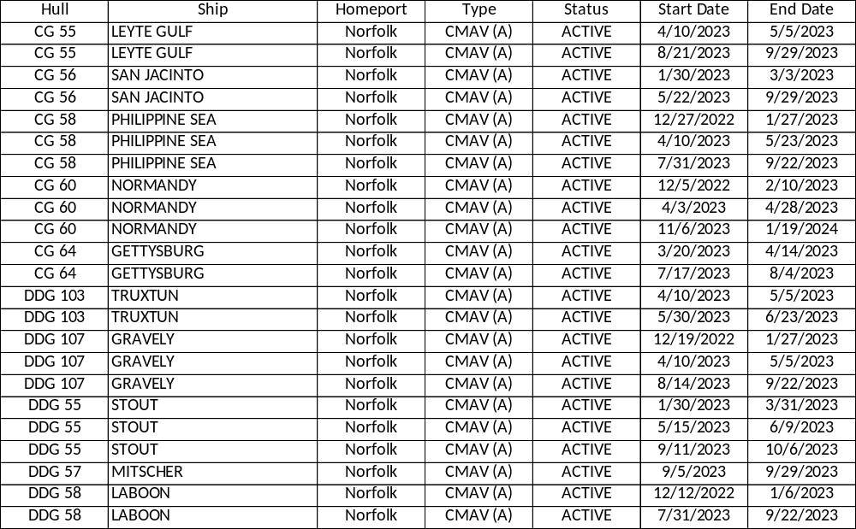
MARMC Private Sector
CMAV Workload Forecast FY23 Q3 – FY24 Q3
Industry Forecast - as of 01 APR 2023
“Intent of this information is to provide U.S. DoD industry contractors a general schedule for information and planning purposes for upcoming surface ship maintenance periods- It does not constitute any request for information or request for proposals or any commitment to contract for work in accordance with this plan. This information is to assist U.S. DoD industry contractors by providing a broad overview of frequently changing (driven by U.S. Navy operations) maintenance schedules and is not a guarantee of workload or exact ship schedules”
“Distribution Statement A: Approved for Public Release; Distribution is unlimited.”

Slide 4
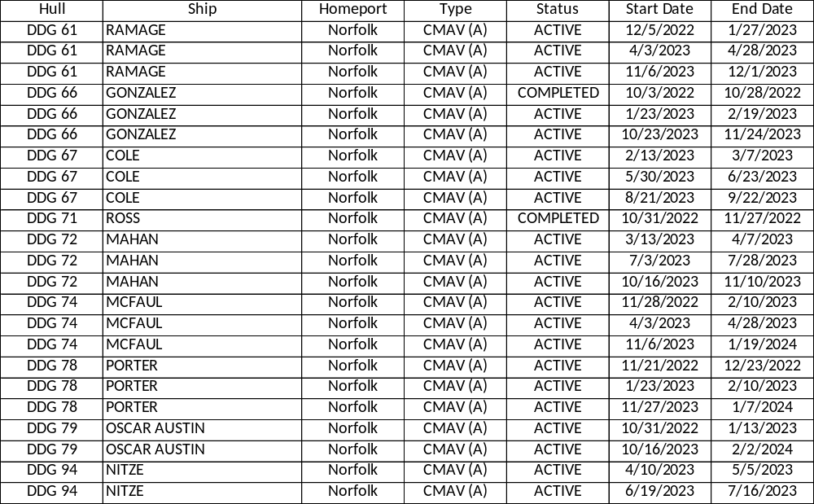
MARMC Private Sector
CMAV Workload Forecast FY23 Q3 – FY24 Q3
Industry Forecast - as of 01 APR 2023
“Intent of this information is to provide U.S. DoD industry contractors a general schedule for information and planning purposes for upcoming surface ship maintenance periods- It does not constitute any request for information or request for proposals or any commitment to contract for work in accordance with this plan. This information is to assist U.S. DoD industry contractors by providing a broad overview of frequently changing (driven by U.S. Navy operations) maintenance schedules and is not a guarantee of workload or exact ship schedules”
“Distribution Statement A: Approved for Public Release; Distribution is unlimited.”

Slide 5
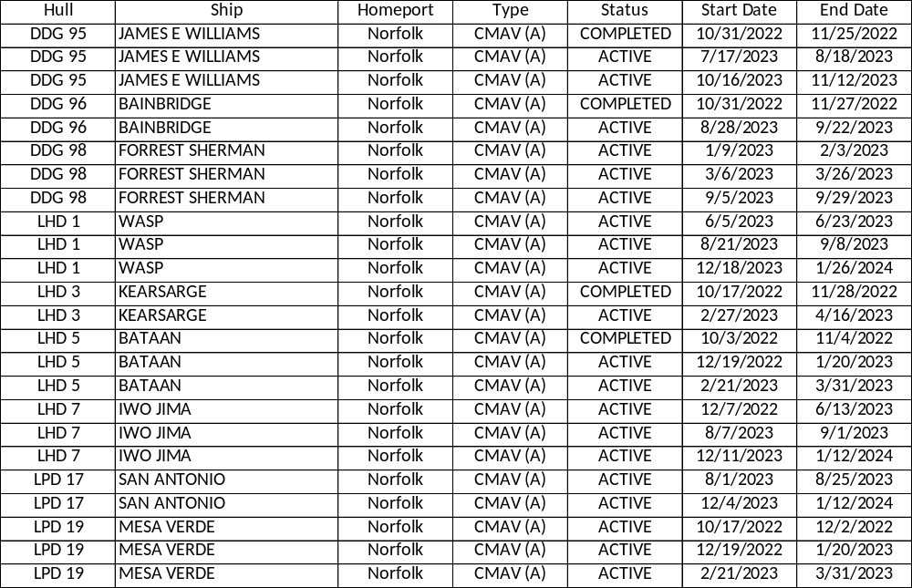
MARMC Private Sector
CMAV Workload Forecast FY23 Q3 – FY24 Q3
Industry Forecast - as of 01 APR 2023
“Intent of this information is to provide U.S. DoD industry contractors a general schedule for information and planning purposes for upcoming surface ship maintenance periods- It does not constitute any request for information or request for proposals or any commitment to contract for work in accordance with this plan. This information is to assist U.S. DoD industry contractors by providing a broad overview of frequently changing (driven by U.S. Navy operations) maintenance schedules and is not a guarantee of workload or exact ship schedules”
“Distribution Statement A: Approved for Public Release; Distribution is unlimited.”

Slide 6
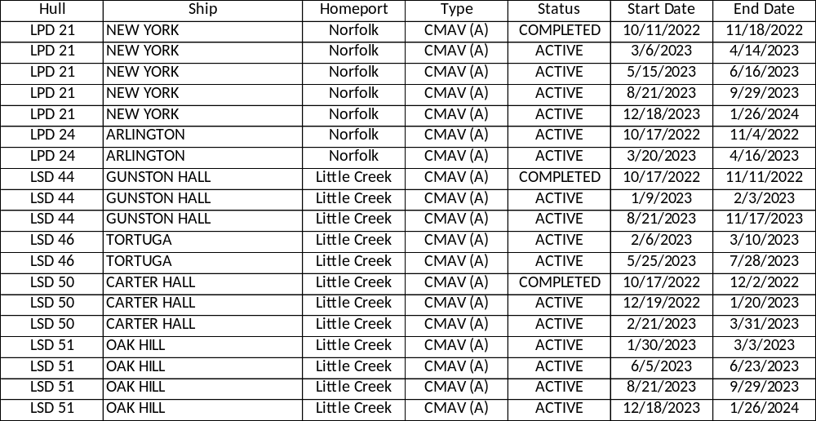
MARMC Private Sector
CMAV Workload Forecast FY23 Q3 – FY24 Q3
Industry Forecast - as of 01 APR 2023
“Intent of this information is to provide U.S. DoD industry contractors a general schedule for information and planning purposes for upcoming surface ship maintenance periods- It does not constitute any request for information or request for proposals or any commitment to contract for work in accordance with this plan. This information is to assist U.S. DoD industry contractors by providing a broad overview of frequently changing (driven by U.S. Navy operations) maintenance schedules and is not a guarantee of workload or exact ship schedules”
“Distribution Statement A: Approved for Public Release; Distribution is unlimited.”

Slide 7
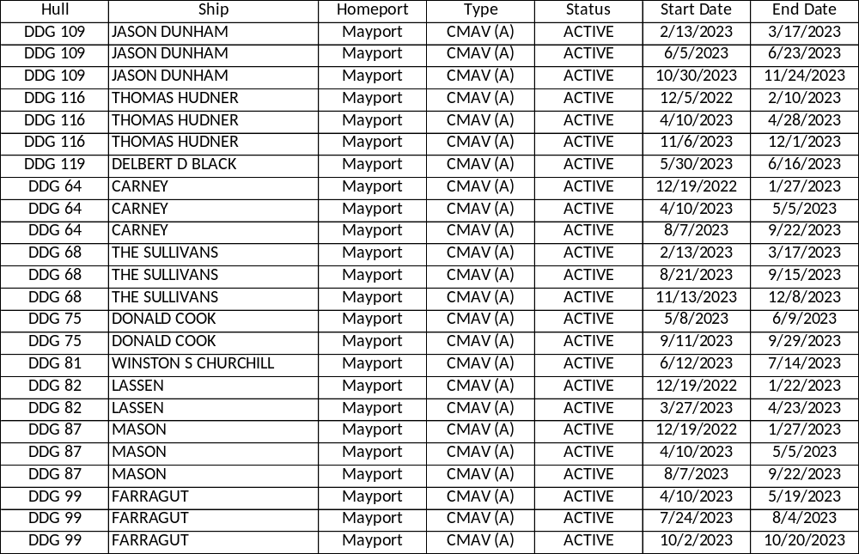
SERMC Private Sector
CMAV Workload Forecast FY23 Q3 – FY24 Q3
Industry Forecast - as of 01 APR 2023
“Intent of this information is to provide U.S. DoD industry contractors a general schedule for information and planning purposes for upcoming surface ship maintenance periods- It does not constitute any request for information or request for proposals or any commitment to contract for work in accordance with this plan. This information is to assist U.S. DoD industry contractors by providing a broad overview of frequently changing (driven by U.S. Navy operations) maintenance schedules and is not a guarantee of workload or exact ship schedules”
“Distribution Statement A: Approved for Public Release; Distribution is unlimited.”

Slide 8
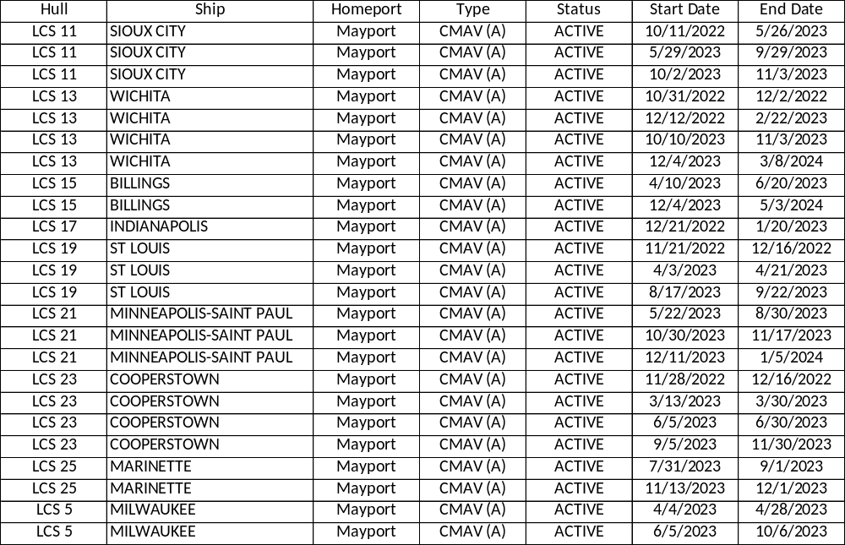
SERMC Private Sector
CMAV Workload Forecast FY23 Q3 – FY24 Q3
Industry Forecast - as of 01 APR 2023
“Intent of this information is to provide U.S. DoD industry contractors a general schedule for information and planning purposes for upcoming surface ship maintenance periods- It does not constitute any request for information or request for proposals or any commitment to contract for work in accordance with this plan. This information is to assist U.S. DoD industry contractors by providing a broad overview of frequently changing (driven by U.S. Navy operations) maintenance schedules and is not a guarantee of workload or exact ship schedules”
“Distribution Statement A: Approved for Public Release; Distribution is unlimited.”

Slide 9
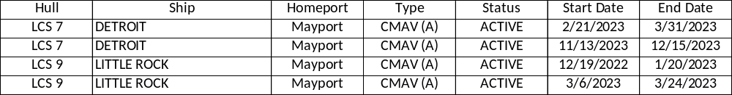
SERMC Private Sector
CMAV Workload Forecast FY23 Q3 – FY24 Q3
Industry Forecast - as of 01 APR 2023
“Intent of this information is to provide U.S. DoD industry contractors a general schedule for information and planning purposes for upcoming surface ship maintenance periods- It does not constitute any request for information or request for proposals or any commitment to contract for work in accordance with this plan. This information is to assist U.S. DoD industry contractors by providing a broad overview of frequently changing (driven by U.S. Navy operations) maintenance schedules and is not a guarantee of workload or exact ship schedules”
“Distribution Statement A: Approved for Public Release; Distribution is unlimited.”

Slide 10
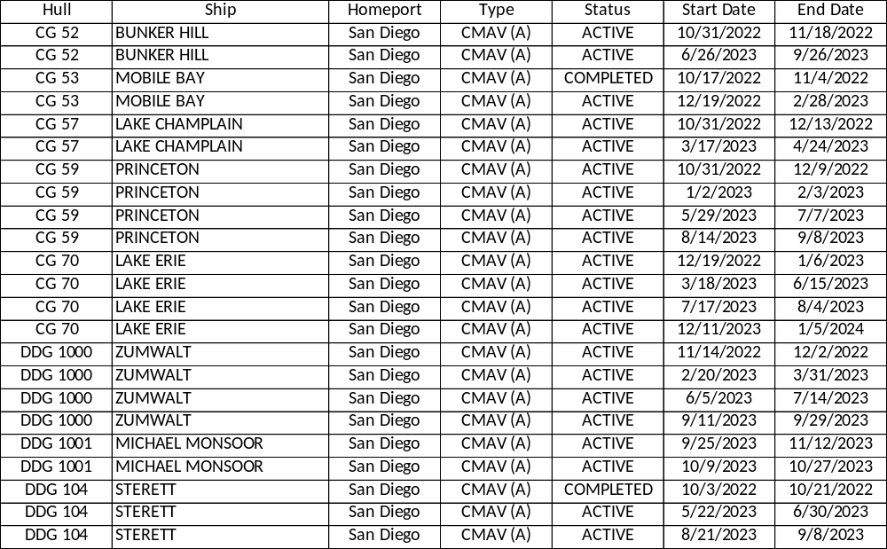
SWRMC Private Sector
CMAV Workload Forecast FY23 Q3 – FY24 Q3
Industry Forecast - as of 01 APR 2023
“Intent of this information is to provide U.S. DoD industry contractors a general schedule for information and planning purposes for upcoming surface ship maintenance periods- It does not constitute any request for information or request for proposals or any commitment to contract for work in accordance with this plan. This information is to assist U.S. DoD industry contractors by providing a broad overview of frequently changing (driven by U.S. Navy operations) maintenance schedules and is not a guarantee of workload or exact ship schedules”
“Distribution Statement A: Approved for Public Release; Distribution is unlimited.”

Slide 11
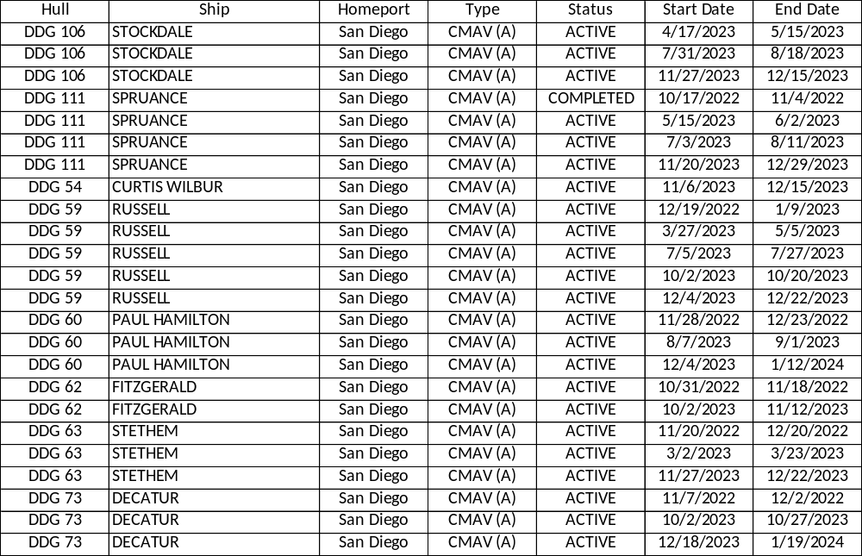
SWRMC Private Sector
CMAV Workload Forecast FY23 Q3 – FY24 Q3
Industry Forecast - as of 01 APR 2023
“Intent of this information is to provide U.S. DoD industry contractors a general schedule for information and planning purposes for upcoming surface ship maintenance periods- It does not constitute any request for information or request for proposals or any commitment to contract for work in accordance with this plan. This information is to assist U.S. DoD industry contractors by providing a broad overview of frequently changing (driven by U.S. Navy operations) maintenance schedules and is not a guarantee of workload or exact ship schedules”
“Distribution Statement A: Approved for Public Release; Distribution is unlimited.”

Slide 12
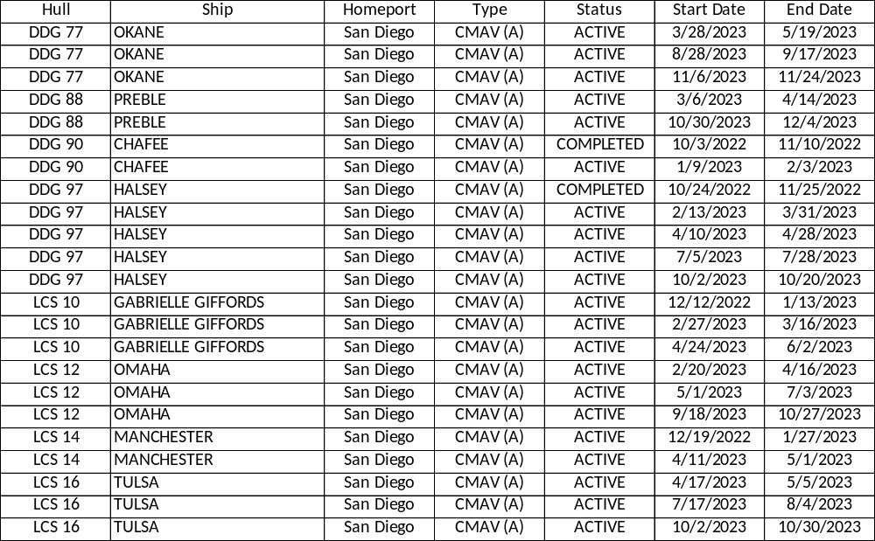
SWRMC Private Sector
CMAV Workload Forecast FY23 Q3 – FY24 Q3
Industry Forecast - as of 01 APR 2023
“Intent of this information is to provide U.S. DoD industry contractors a general schedule for information and planning purposes for upcoming surface ship maintenance periods- It does not constitute any request for information or request for proposals or any commitment to contract for work in accordance with this plan. This information is to assist U.S. DoD industry contractors by providing a broad overview of frequently changing (driven by U.S. Navy operations) maintenance schedules and is not a guarantee of workload or exact ship schedules”
“Distribution Statement A: Approved for Public Release; Distribution is unlimited.”

Slide 13
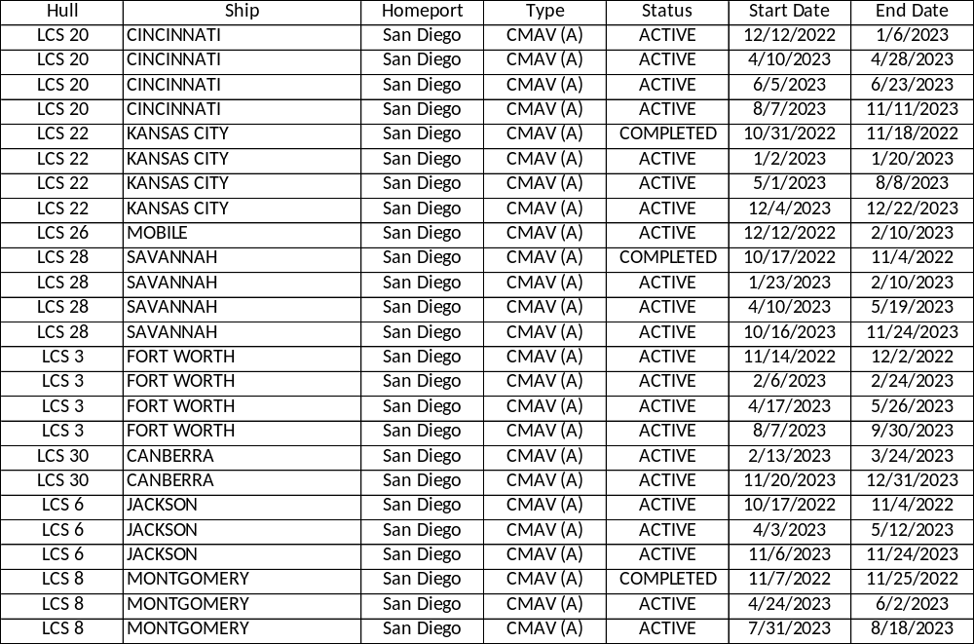
SWRMC Private Sector
CMAV Workload Forecast FY23 Q3 – FY24 Q3
Industry Forecast - as of 01 APR 2023
“Intent of this information is to provide U.S. DoD industry contractors a general schedule for information and planning purposes for upcoming surface ship maintenance periods- It does not constitute any request for information or request for proposals or any commitment to contract for work in accordance with this plan. This information is to assist U.S. DoD industry contractors by providing a broad overview of frequently changing (driven by U.S. Navy operations) maintenance schedules and is not a guarantee of workload or exact ship schedules”
“Distribution Statement A: Approved for Public Release; Distribution is unlimited.”

Slide 14
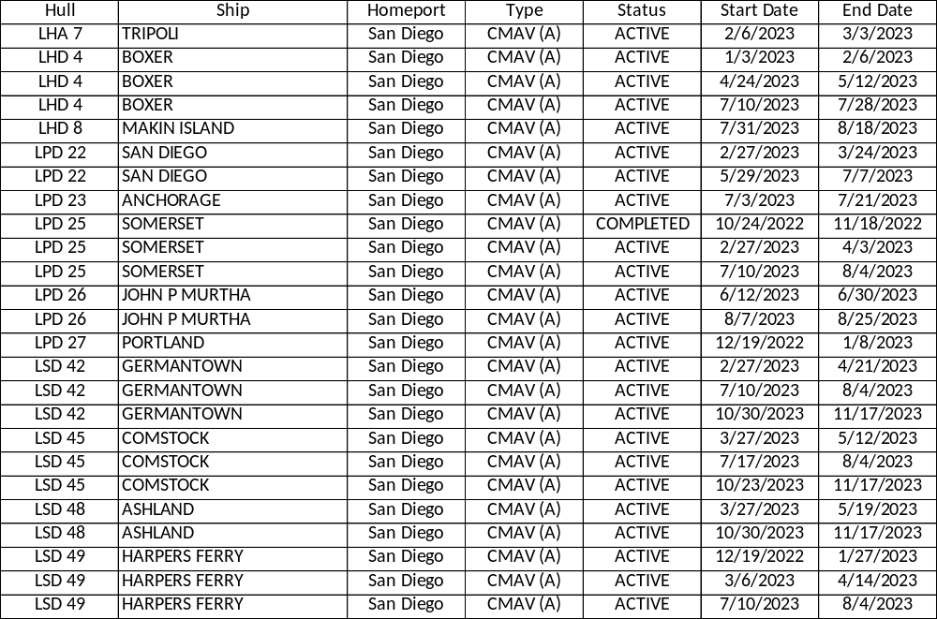
SWRMC Private Sector
CMAV Workload Forecast FY23 Q3 – FY24 Q3
Industry Forecast - as of 01 APR 2023
“Intent of this information is to provide U.S. DoD industry contractors a general schedule for information and planning purposes for upcoming surface ship maintenance periods- It does not constitute any request for information or request for proposals or any commitment to contract for work in accordance with this plan. This information is to assist U.S. DoD industry contractors by providing a broad overview of frequently changing (driven by U.S. Navy operations) maintenance schedules and is not a guarantee of workload or exact ship schedules”
“Distribution Statement A: Approved for Public Release; Distribution is unlimited.”

Slide 15
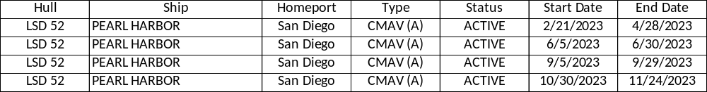
SWRMC Private Sector
CMAV Workload Forecast FY23 Q3 – FY24 Q3
Industry Forecast - as of 01 APR 2023
“Intent of this information is to provide U.S. DoD industry contractors a general schedule for information and planning purposes for upcoming surface ship maintenance periods- It does not constitute any request for information or request for proposals or any commitment to contract for work in accordance with this plan. This information is to assist U.S. DoD industry contractors by providing a broad overview of frequently changing (driven by U.S. Navy operations) maintenance schedules and is not a guarantee of workload or exact ship schedules”
“Distribution Statement A: Approved for Public Release; Distribution is unlimited.”

Slide 16
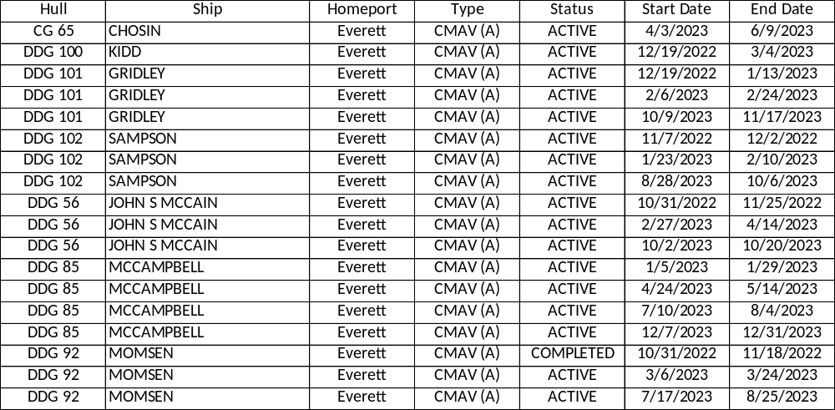
NWRMC Private Sector
CMAV Workload Forecast FY23 Q3 – FY24 Q3
Industry Forecast - as of 01 APR 2023
“Intent of this information is to provide U.S. DoD industry contractors a general schedule for information and planning purposes for upcoming surface ship maintenance periods- It does not constitute any request for information or request for proposals or any commitment to contract for work in accordance with this plan. This information is to assist U.S. DoD industry contractors by providing a broad overview of frequently changing (driven by U.S. Navy operations) maintenance schedules and is not a guarantee of workload or exact ship schedules”
“Distribution Statement A: Approved for Public Release; Distribution is unlimited.”

Slide 17
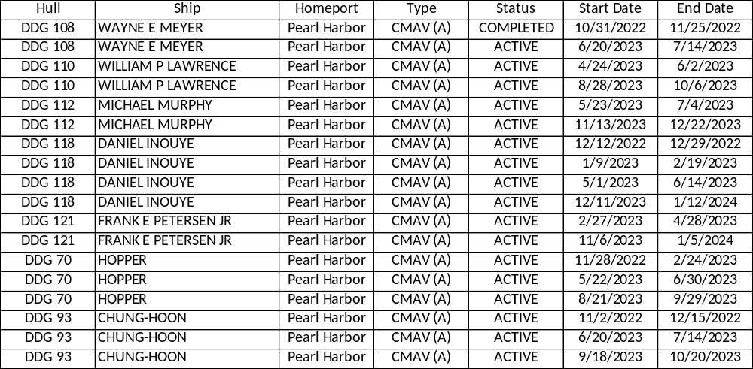
HRMC Private Sector
CMAV Workload Forecast FY23 Q3 – FY24 Q3
Industry Forecast - as of 01 APR 2023
“Intent of this information is to provide U.S. DoD industry contractors a general schedule for information and planning purposes for upcoming surface ship maintenance periods- It does not constitute any request for information or request for proposals or any commitment to contract for work in accordance with this plan. This information is to assist U.S. DoD industry contractors by providing a broad overview of frequently changing (driven by U.S. Navy operations) maintenance schedules and is not a guarantee of workload or exact ship schedules”
“Distribution Statement A: Approved for Public Release; Distribution is unlimited.”

