Slide 1
UNNO Industry Day
07 Aug 2026

Slide 2
UNNO Industry Day Agenda
Time | Session | Lead
9:05 – 9: 10 | Welcome | Davey Jones
9:00 – 9:05 | Purpose & Ground Rules | Ben Kamp
9:05 – 9:15 | SCaN Program Welcome | Jena Garrahy
9:15 – 9:35 | UNNO Overview | Davey Jones
9:35 – 10:15 | Scope Overview | Shane Canerday
10:15 – 10:35 | Facilitated Q&A
10:35 – 10:45 | Break
10:45 – 11:25 | Acquisition Approach | Ben Kamp
11:25 – 11:45 | Facilitated Q&A
11:45 – 12:00 | Closing Remarks and Next Steps | Davey Jones

Slide 3
Purpose and Ground Rules
Industry Day is a pre-solicitation exchange technique under FAR 15.201(c) and supports market research under FAR 10.001 and 10.002
This is not a solicitation. No contract will be awarded from today or from RFI responses, and NASA will not reimburse response preparation costs — FAR 15.201(e)
The acquisition approach is pre-decisional. Nothing presented today constitutes a Government decision on structure, contract type, or award approach
NASA is also offering one-on-one sessions —Participation is voluntary and confers no advantage
All charts, the question-and-answer record, and any acquisition information provided in one-on-one sessions will be posted to SAM.gov so every interested party has equal access — FAR 15.201(f)
Procurement integrity requirements apply to all exchanges — FAR 3.104

Slide 4
SCaN
Space Communications and Navigation Program Overview
Jena Garrahy
Deputy Program Manager, Operations

Slide 5


The SCaN Program operates and manages the crucial communications and navigation systems for NASA missions.
From missions exploring beyond our solar system, to astronauts onboard the International Space Station, space communications provide the connection to Earth.
5

Slide 6

SCaN: Enabling Science & Exploration
SCaN is evolving NASA’s architecture to provide more robust, cost-effective services to missions.
OPERATIONAL NETWORKS
Near Space Network (NSN)
Deep Space Network (DSN)
ENHANCEMENTS & CAPABILITIES
Antenna Enhancement (DAEP)
Lunar Relays (LCRNS)
Commercial Relays (CSP)
Lunar Ground Segment (NSNS; LEGS; DLEU)
Delay Tolerant Networking (DTN)
Cloud Storage & Services (Daphne+)
TECHNOLOGY DEVELOPMENT
Autonomous Navigation (AutoNGC)
GPS at the Moon (Lunar mGNSS)
Laser / Optical Communications (O2O)
Lunar Networking & Nav (LunaNet; Lunar 3GPP; LSP)
Service Roaming - Wideband (PExT)
On-the-Move Communications (KaSTLE)
6

Slide 7









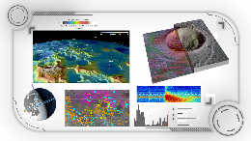















NASA SCaN Evolving Architecture
MARS
MTN
Constellations
Low Orbit Relay Orbiter
Science / Relay Orbiter
EARTH
TDRSS Comms Network
ORBITAL OBSERVABILITY
To Earth Receiver
MOON
DSOC/PSYCHE
-Optical User Terminal
(307-million miles)
CSP Providers (7)
24/7 Southern Hemispheric RF
Surface Imaging
Space Weather
Widefield SSA
StarShield
PExT Demo
Lunar Commercial Relay
Constellation #1
Communications
PNT
Observation
Artemis Orion O2O Optical Demo
NEXUS (Network Extension for User Continuity and Sustainability)
EARTH: GROUND ASSETS
Lunar Commercial Relay
Constellation #2
Communications
PNT
Observation
MOON BASE INFRASTRUCTURE
Surface Observability
PNT, Navigation, Atomic Clocks
Surface 3GPP
Lunar GNSS Receiver Experiment (LuGRE) - tracked GPS & Galileo at 225,000 miles on lunar surface
Deep Space Network (DSN)
with StarShield
(~10 arcsecond pointing accuracy)
Near Space Network (NSN) Ground
Segment
Commercial Ground
Providers
Lunar Exploration Ground Sites (LEGS) – 20m lunar class antennas
TDRSS
Ground
Segment
Optical Ground Segment
Lunar Data Management

Slide 8

Communications and Navigation
Integral to Mission Success
NASA’s reliable networks have enabled key exploration and scientific milestones for over six decades.
NASA evolves comm and nav technologies to expand the mission capabilities.
NASA partners with industry to maximize service, support, and stimulate the space economy.

Slide 9
UNNO Overview
Davey Jones

Slide 10
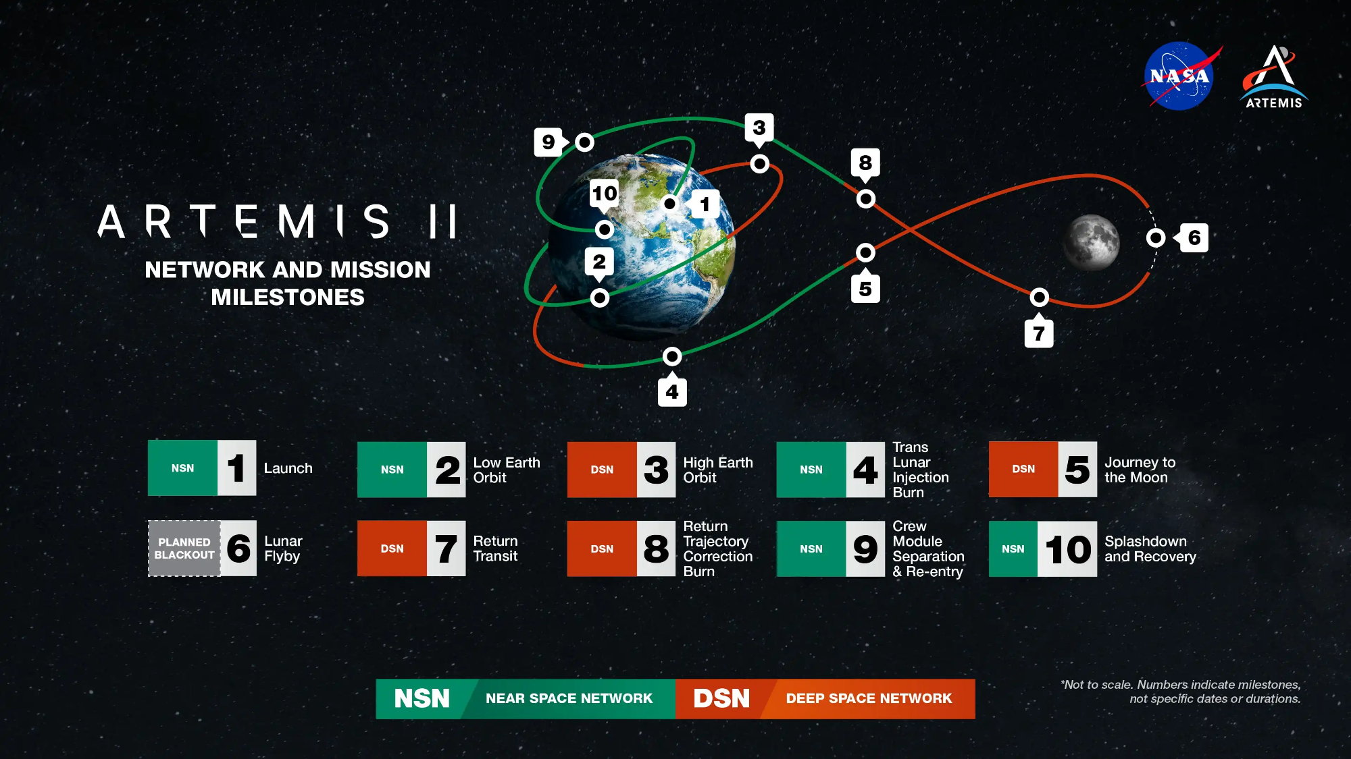

Slide 11
Why Now? – UNNO Primary Drivers
1
SCaN has committed to One Network. NASA currently manages NSN and DSN through separate contracts with uneven site-level constructs. The management model has to follow the operational model.
Strategic Direction
2
Fixed-price, performance-based contracting is the preferred method of procurement. Current legacy contracts are cost-type. That gap must be closed deliberately, not incidentally.
Executive Order 14402
3
The two contracts supporting DSN and NSN reach the end of their periods of performance. Recompeting them separately would lock in the current fragmentation for another contract cycle.
Legacy Contract Expirations
UNNO is the contractual mechanism to implement One Network

Slide 12
One Network Requires One Acquisition Framework
Current State
Multiple contracts across NSN and DSN
Inconsistent approaches across sites
Uneven governance and reporting
Limited enterprise cost control
Fragmented accountability
UNNO Shift
One acquisition construct
One common management framework
Standardized expectations
Better enterprise integration
Improved visibility and control
One Network Outcome
Consistent cross-site management
Common cost and performance framework
Stronger enterprise accountability
Modernization planned within one framework, not layered onto legacy fragments
Standardize service delivery, industrial safety, sustainment, engineering integration, reporting, cybersecurity, and performance oversight across sites.
Improve cost visibility and control through a common framework for measuring services, outcomes, and expenditures.
Reduce contractual disconnects between sites, functions, and mission support that increase management complexity today.
Two cost-type contracts currently support these efforts.
Both will be replaced under the UNNO construct.

Slide 13
UNNO Goals & Objectives
UNNO exists to deliver reliable, efficient, secure, and innovative communication and navigation services — managed as one network rather than two.
Goal | What It Means | How We Would Know
1. Mission continuity | Services do not degrade — during transition or in steady state. Includes readiness to support Artemis and other critical events | Availability and proficiency standards sustained without interruption through transition; no mission impact attributable to the change
2. One experience for the mission | A mission should not have to learn two networks. Standardized interfaces, protocols, scheduling, and onboarding regardless of where it flies | A single onboarding path and common interface documentation; missions no longer navigate parallel constructs
3. Lower and more predictable cost | Reduce cost through common systems, tools, and processes — and make what remains predictable, consistent with EO 14402 | Fixed price for stable recurring work; enterprise cost visibility across the network rather than per network
4. Manage as an integrated whole | Enterprise coordination, consistent governance, and clear accountability across sites and functions | Key performance indicators tracked across the integrated network; consistent reporting and one accountable performer for O&M
5. Improve, not just sustain | The contractor is chartered to bring forward ideas — automation, digitalization, and better methods — not only to execute the baseline | Demonstrated improvement in reliability, cycle time, or cost; new missions, providers, and services integrated without bespoke effort
Elements Delivering These Goals
Unified Network Management
Operations & Maintenance
Development & Modernization

Slide 14
Known Challenges
Challenge | Why It Is Hard
Moving from cost-plus award fee to a hybrid FFP/cost structure | Risk allocation changes materially. Both parties need confidence that the work is definable enough to price
Requirements definition at sufficient detail to support FFP | Operations work that has been managed on a cost basis for years is not always documented to the level fixed pricing requires
Decomposing the SOW into performance work statements at task order level | Success depends on disciplined requirement decomposition and well-constructed service measures
Redesigning incentives | Shifting incentive structure from Award fee motivation to performance-based metrics with monetary incentive.
Executing a multi-partner environment | One O&M performer and multiple development performers must interoperate and exchange data reliably
Transition without service disruption | Two networks, geographically distributed, operating continuously, with certification and clearance dependencies
Our open challenges map directly to the industry inputs we’re seeking, ensuring feedback informs gaps, risks, and solution paths.

Slide 15
UNNO Scope Overview
Shane Canerday

Slide 16
Scope at a Glance
The draft SOW describes the functions needed to support an integrated end-to-end network. Task orders will define the specific work.
SOW Area | What It Covers
General Requirements | Requirements framework and service performance standards applied across the network
Management | Program management, mission assurance, industrial safety and EHS, security, and cybersecurity
Unified Network Management | Evolution and standardization, continuous improvement, integration, KPI tracking, enterprise coordination
Operations & Maintenance | Operations, COOP, maintenance, recurring sustaining engineering, facilities, logistics, spectrum
Development & Modernization | Systems architecture and engineering, special studies and MI&SS, integration and test, mission integration, non-recurring sustaining engineering
The SOW governs.
Where anything said today differs from the posted draft SOW, the SOW controls.

Slide 17
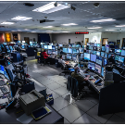





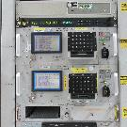
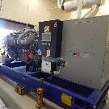

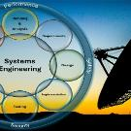

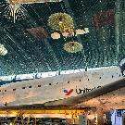
Representative Functions Performed Across the Network
Operations Department
Technical Operations & Analysis
IT Security
24x7 certified crews and support staff.
Experts chartered to support launches, docking, undocking, and splashdown.
Safeguard information and technology infrastructure from various threats and vulnerabilities.
Network Integrity
Systems Integration & Test
Computer & Network Eng
Communications, Physical, and Personnel Security
Responsible for testing and verification of change to the operational system.
Responsible for system maintenance to include, system administration and network administration.
Hardware Maintenance Depot
Facilities
Software Eng.
Responsible for maintaining and repairing system hardware. Includes 24x7 personnel for emergency HW repair.
Responsible for 24x7 maintenance and operational support of operations buildings, antenna structures, & buildings
Responsible for software development and maintenance.
Systems Engineering
Training & Documentation
Specialized Functions
Ensures that the system technically fulfills the defined needs and requirements and that a proper system engineering approach is being followed.
Responsible for developing and delivering training programs. Technical publication are responsible for updating procedures.
Spacecraft Engineering
Mission Integration
Spectrum Management
Specific functions and staffing vary by site.

Slide 18
UNNO Footprint
Legacy Deep Space Network
Central management and support
Global logistics support
Goldstone Deep Space Communications Complex (CA)
Merritt Island, FL — MIL-71 launch support facility
Coordination only: Madrid (MDSCC) and Canberra (CDSCC) — O&M obtained through international agreement
Legacy Near Space Network
Space Relay ground: White Sands Complex, Guam Remote Station, Blossom Point Remote Station, Australian TDRS Facility
Direct-to-Earth: Wallops (VA), McMurdo (Antarctica), White Sands 1 (NM), Fairbanks (AK), Kennedy Uplink Station and Ponce de Leon (FL)
Other supporting facilities
Space Segment — TDRS Constellation
  Geosynchronous satellites over the Atlantic, Pacific, and Indian Ocean Regions, operating 24 hours a day, 365 days a year
  1st generation: TDRS-3 (storage), TDRS-5, -6, -7 | 2nd generation: TDRS-8 | 3rd generation: TDRS-11, -12, -13 | plus STPSat-6

Slide 19
Legacy DSN
Communication and navigation services beyond approximately two million kilometers from Earth.
Follow-the-Sun Operations
Each complex is responsible for management of the full DSN communication network. A single complex monitors and controls all DSN connections during its location’s daylight hours, with handovers between complexes at approximately the change in prime shift.
In scope under UNNO
Goldstone Deep Space Communications Complex
DSN technical engineering support staff
Global logistics support
Operations in support of all NASA deep space missions
Maintenance of 34-meter and 70-meter antennas and supporting subsystems
International complexes
Madrid and Canberra operations and maintenance are obtained through international agreement — not under this contract
The contractor provides global logistics coordination support to the worldwide DSN footprint
Interface with international sites for consistency of upgrades and efficiencies
Complexes are being upgraded to meet Artemis requirements while sustaining the science mission set
For UNNO the focus is Goldstone and its supporting capabilities — with a continuing interface to the international sites.

Slide 20
Legacy NSN
Communication and navigation services from zero to approximately two million kilometers above Earth.
Space Relay Service
  Previously known as the Space Network
  TDRS constellation in geosynchronous orbit across the Atlantic, Pacific, & Indian Ocean Regions
  The constellation evolves as spacecraft age and are repositioned
  TDRS Operations and Control Center at White Sands Complex is the primary hub for operations
  Safe and secure operation of TDRS spacecraft, maximizing potential lifetime
  Commercial service providers are being added, with NASA administering the contracts
Direct-to-Earth Service
  Previously known as the Near Earth Network
  Telemetry, tracking, and commanding; high-rate data acquisition downlink; radiometric tracking
  Delivered through a global network of NASA and commercial ground stations
  Supports low Earth, geosynchronous, highly elliptical, Lagrange, lunar orbit and surface, sub-orbital, and launch trajectories
  25-year history of commercial service providers under NASA-administered contracts
  Coordination with commercial providers is a contract requirement
As commercial capabilities increase, the government-owned footprint may decrease through the life of UNNO.

Slide 21
Legacy Performance Requirements
Network | Measure | Standard
Near Space Network | Service availability — nominal | ≥ 97% averaged over one month
 | Service availability — critical | ≥ 99% averaged over one month
 | Operational service proficiency (SR Only) | ≥ 99.90% averaged over one month (standard of excellence ≥ 99.97%)
 | Operational service proficiency (DTE Only) | ≥ 99.0% averaged over one month
Deep Space Network | Service availability — nominal | 95%
 | Service availability — mission critical event | 98%
UNNO Performance:
Detailed, service-specific performance requirements will be defined at the task order level

Slide 22
Statement of Work
Management Requirements
  Program Management: technical, cost, schedule, and risk management; Task Implementation Plans with WBS and cost proposals
  Mission Assurance Program: risk management, quality assurance, government insight/support, and subcontractor flow-down
  Industrial Safety Program: hazard identification, safe work planning, stop-work authority, and a strong safety culture
  Security & Cybersecurity: COMSEC, PERSEC, PHYSEC, OPSEC, INFOSEC, incident response
Operations and Maintenance
  24x7 network operations of NSN with Follow-the-Sun Operations across the DSN
  Unified scheduling, conjunction assessment/avoidance, and critical event support (launches, planetary encounters, Artemis operations)
  Recurring sustaining engineering, including Sustainment Plans and TDRS constellation engineering
  Facilities O&M, logistics/property management
Development and Modernization
  Special Studies & Initiatives, including Mission Integration and Special Studies (MI&SS) task orders for unique network needs
  Integration & Test: new mission integration, interface compatibility testing, and integrated network testing
  Mission Integration & Customer Commitment: mission catalog, onboarding support, Mission Interface Manager (MIM)/MIEM functions, SLAs, NSRDs, and SARDs
  Non-recurring sustaining engineering: system sustainability plans, obsolescence identification, and budgetary estimates for modernization

Slide 23
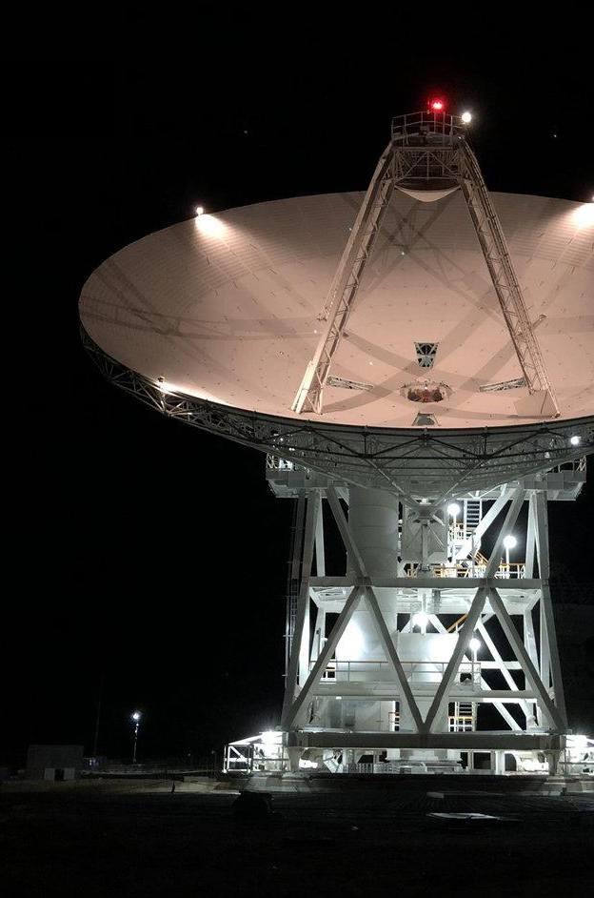
SOW Key Takeaways for Industry
The draft SOW operationalizes the One Network vision across management, DSN, NSN operations, and modernization within a single task order framework.
Task orders will define specific requirements, performance standards, deliverables, and Government-furnished property/information for each network.
Requirements span mission assurance, industrial safety, security, cybersecurity, facilities, logistics, and spectrum management — not just network operations.
Industry feedback through the RFI will directly shape FFP suitability, performance metrics, and transition planning before the contract language is finalized.

Slide 24
UNNO Acquisition Overview
Ben Kamp

Slide 25
Alignment with Executive Order 14402
Promoting Efficiency, Accountability, and Performance in Federal Contracting — EO 14402
“While there are circumstances in which cost-reimbursement contracting is appropriate, such as research and the pre-production developmental phase of major systems acquisition, it should be the exception, granted only in limited circumstances… …it is the policy of my Administration that fixed-price contracts with performance-based considerations should serve as the default and preferred method of procurement."
UNNO proposes a structure centered on firm-fixed-price for stable, recurring functions
The RFI is being used, in part, to determine where FFP is genuinely supportable, what information industry needs to price it, and what exceptions remain justified
UNNO is also assessing how automation, digitalization, metrics, incentives, and transition design can improve performance and lower cost under the final construct
This approach supports the intent of the Executive Order while preserving flexibility to adopt better industry-informed alternatives before the acquisition is finalized
We are asking for constructive feedback on contract type and incentive structure.

Slide 26
One Construct, Two Categories:
Stable O&M and Competing Modernization
Proposed Hybrid FFP/Cost, Multiple Award Task Order Contract (MATOC)
How will it Function?
UNNO Common Management Framework
Category 1: Operation and Maintenance
Performance-Based Services with FFP Task Orders
FFP Task Orders for Baseline O&M
Cost Plus Task Orders for Emergency and Non-Baseline O&M
Surge support as either FFP or Cost Plus as appropriate
Category 2: Development and Modernization
Cost Plus or FFP (whichever is appropriate)
Multiple award
Competition among contract holders as requirements come up
Can also award current requirements at initial solicitation
Cost type TO must have a path toward FFP sustainment
Agency and Industry input will inform final acquisition approach

Slide 27
Sample Task Order Timeline
The purpose of this timeline to illustrate how the IDIQ structure could function. The dates and timelines are notional.
 | Category 1 – Can issue sole source TO’s
Evaluate Category 1 (1 Award)
Contract Award | Year 1 | Year 2 | Year 3 | Year 4 | Year 5 | Year 6 | Year 7
Evaluate Category 2
 | Category 2 – Must compete and provide fair opportunity to all contract holders
TO 06 – O&M DSN (5 Year PoP)
TO 01 – O&M NSN (5 Year PoP)
TO 02 – Site A Modernization
TO 03 – Development
TO 04 – Development
TO 05 – Site B Modernization
TO 07 – Development

Slide 28
Integral Contract Feature
Contractor Collaboration and Data Exchange Obligations:
  Ensure development and modernization contractors meet interoperability requirements and share data to enable continued operation and maintenance by a separate contractor.
  Likewise, the O&M contractor should share data with the development and modernization contractors to achieve interoperability requirements.
  Primarily accomplished through associate contractor agreements (ACA's).

Slide 29
UNNO Wrap Up
Davey Jones

Slide 30
Notional Near-Term Schedule
Milestone | Status / Date
RFI Release | 15 Jul
Industry Day Briefing | 07 Aug
Industry 1 on 1s | 10 Aug (week of)
RFI Responses Due | 15 Aug
Site Visits with Industry (TBC) White Sands, Goldstone, Wallops | Sep-Oct
Draft RFP | 30 Oct

Slide 31
Points of Contact
Role | Name | Contact Info (email)
Contracting Officer | Benjamin Kamp | benjamin.m.kamp@nasa.gov
UNNO Project Manager | Davey Jones | davey.jones@nasa.gov
Requirement Development Lead | Shane Canerday | shane.a.canerday@nasa.gov

Slide 32


S PA C E O P E R AT I O N S M I S S I O N D I R E C T O R AT E S PA C E C O M M U N I C AT I O N S & N AV I G AT I O N

Slide 33
Submission Guidelines
Submission channel: TBD — to be specified by the Contracting Officer (e.g., SAM.gov or agency portal)
Proposal format and page-limit requirements: TBD — to be defined in the final RFP
Proposals Due: Mar 2027 TBC
Participants are encouraged to submit comprehensive, compliant proposals to support effective and fair evaluation
Evaluation is expected to weigh past performance, cost efficiency, and technical merit, consistent with FAR 15.304 evaluation factors
Questions on submission mechanics should be directed to the Contracting Officer

